Slide 1
k_{off}课题文献汇报
1. MD Simulations for Drug-Target (Un)Binding Kinetics
Steffen Wolf
2. Predicting biomolecular binding kinetics: A review
Jinan Wang, et al.
3. Recent advances in computational methods for studying ligand binding kinetics
Farzin Sohraby, et al.
汇报人：吴乐云
2023 年 03 月 09 日

Slide 2
CONTENT
1. About the Author
2. Biased MD methods
3. Databases of biomolecular binding kinetics
4. Brief summary of computer simulation predicted k_{off}
5. The trypsin-benzamidine complex
6. vsREMD + MSM

Slide 3
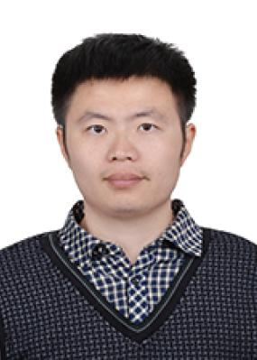
1.2
1. The Authors
Steffen Wolf
Jinan Wang
Ariane Nunes Alves
Privatdozent (Senior Scientist)
Institute of Physics
Albert Ludwigs University Freiburg
University of Kansas
Technische Universität Berlin
柏林工业大学
弗莱堡阿尔伯特路德维希大学

Slide 4
1.2
2. Biased MD
Steffen Wolf
Kramers rate theory
preexponential factor
Boltzmann probability

Slide 5
1.2
2. Biased MD
Steffen Wolf
Kramers rate theory
preexponential factor
Boltzmann probability
Hard to calculate
The fraction usually cannot be solved analytically.

Slide 6
1.2
2. Biased MD
Steffen Wolf
Kramers rate theory
preexponential factor
Boltzmann probability
Hard to calculate
The fraction usually cannot be solved analytically.
Free energy barrier and temperature
All biased techniques employed for
rate prediction modulate these two parts

Slide 7
1.2
2. Biased MD
Steffen Wolf
Temperature-scaling
Temperature-accelerated MD
It is less suited for the k_{off} -problems, as protein structures are sensitive to high temperatures that would be necessary for a sufficient acceleration.
Bias potential-based methods
Metadynamics, Ga-MD
Biased potential methods employ a potential, that is added to the system Hamiltonian, leading to an adjusted probability.
Bias force-based methods
steered MD, targeted MD, random acceleration MD (RAMD)
Instead of employing bias potentials to drive a ligand out from its binding site, it is feasible to pull it out actively.

Slide 8
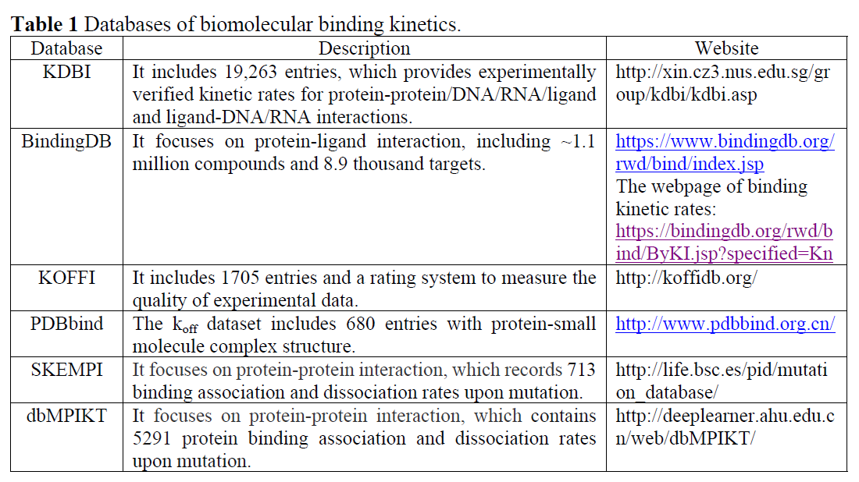
1.2
3. Databases
Jinan Wang, et al.

Slide 9
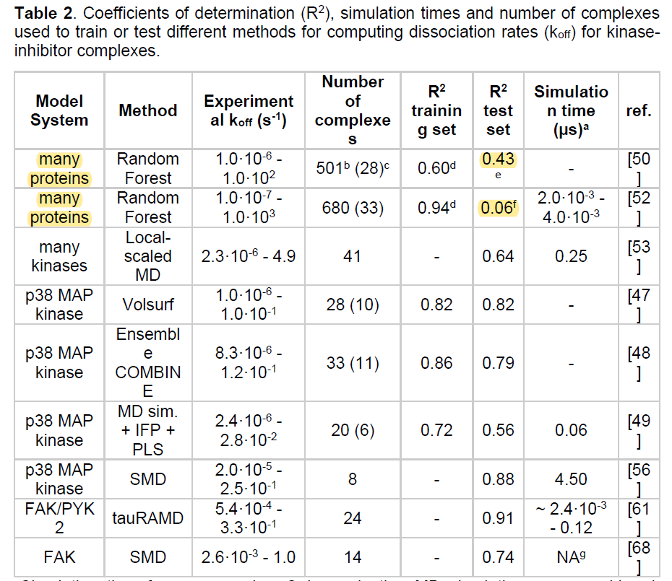
1.2
4. Brief summary
Farzin Sohraby, et al.
The Random Forest method shows low R²
TauRAMD is the so far best-established method for relative unbinding rate prediction

Slide 10
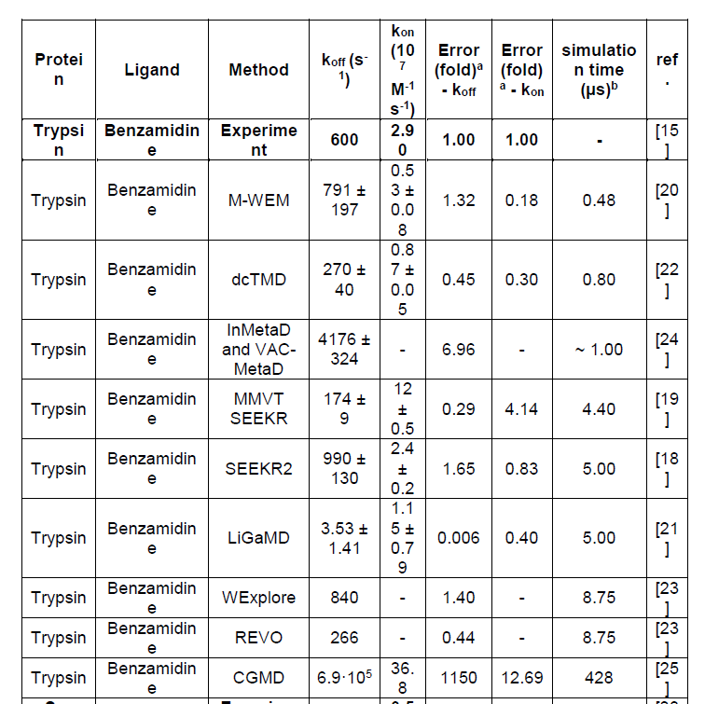
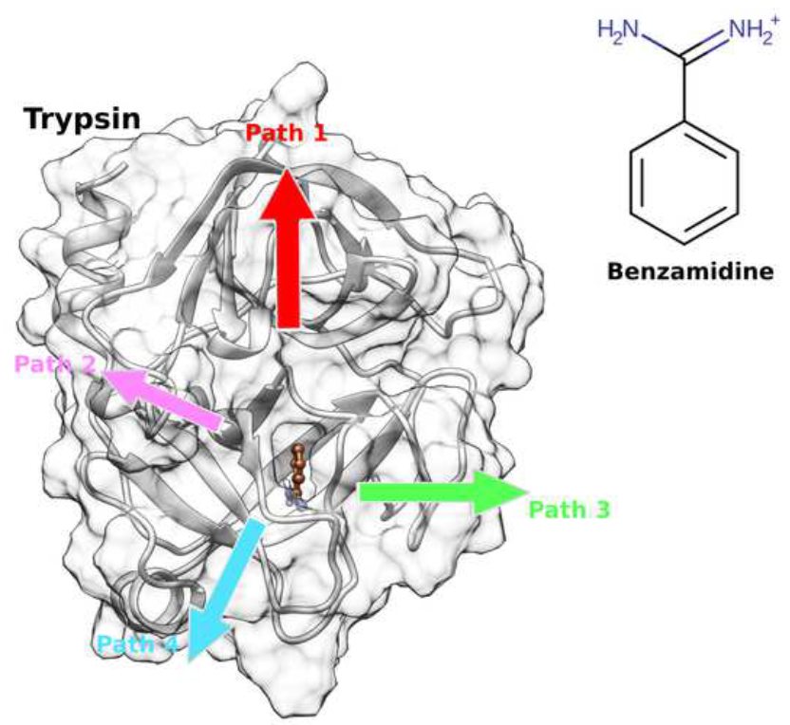
1.2
5. Trypsin-benzamidine
Farzin Sohraby, et al.
The trypsin-benzamidine complex as a model system to benchmark new computational methods

Slide 11
1.2
6. vsREMD + MSM
Markov State Models
状态分布矩阵
转移概率矩阵
MD轨迹
微状态划分
MFPT
Journal of the American Chemical Society 2018 Vol. 140 Issue 7 Pages 2386-2396

Slide 12
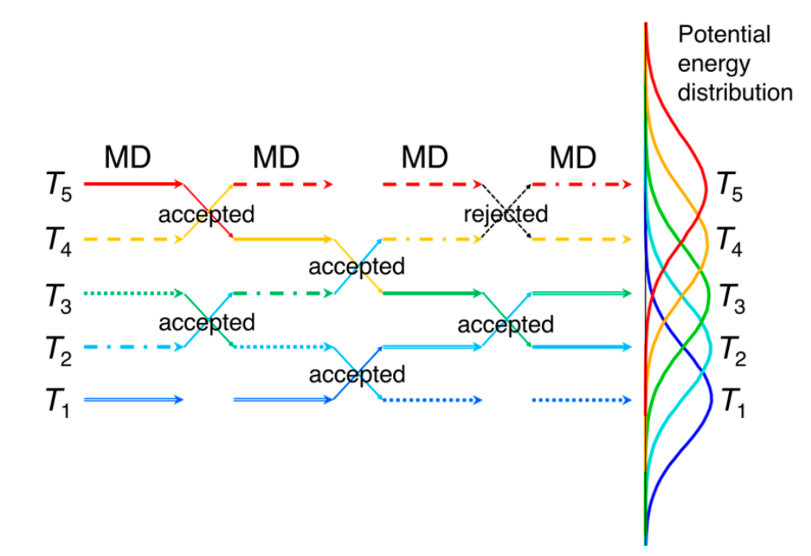
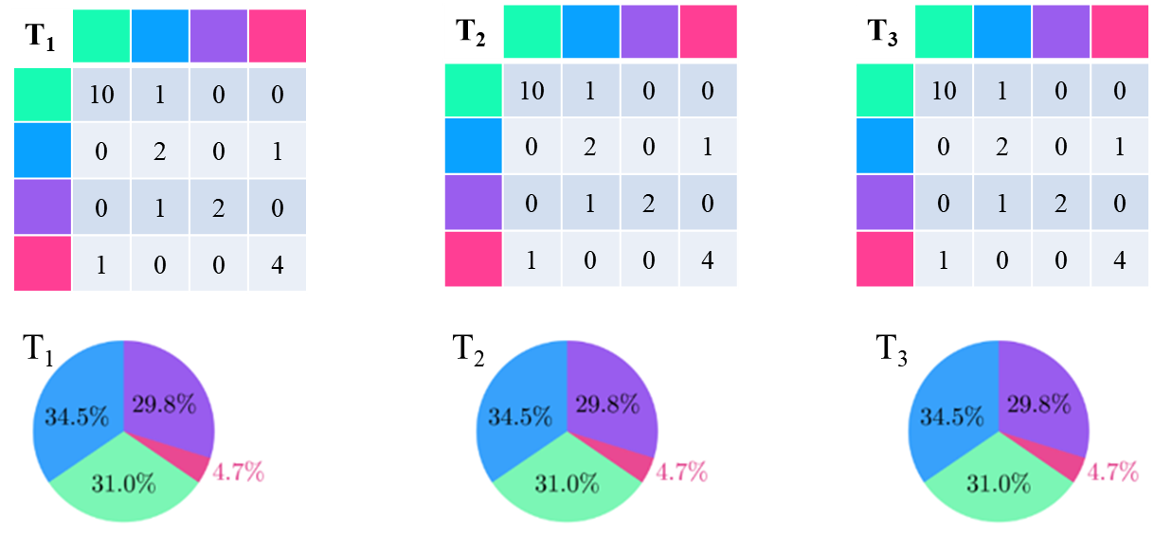
1.2
6. vsREMD + MSM
Replica Exchange Molecular Dynamics
温度离散型轨迹
转移概率矩阵
Case 1:
各个温度下的系综均达到采样平衡，可以计算出每个T下的MFPT
Case 2:
状态分布矩阵
将T₂和T₃中的转移概率和状态分布合并到T₁
理想情况下，二者计算出的结果应该一致？
Notes:
重点是得到准确的状态分布矩阵和转移概率矩阵。

Slide 13
1.2
6. vsREMD + MSM
Replica Exchange Molecular Dynamics
温度离散型轨迹
状态分布矩阵
转移概率矩阵
MD轨迹
微状态划分
MFPT
如何确认要划分的时间尺度？（单位时间）
如何聚类形成合适的微状态？
如何验证模型的MSM性质？
如何对不同T下的状态分布和转移概率进行reweighting？
Notes:
重点是得到准确的状态分布矩阵和转移概率矩阵。

Slide 14
THANK YOU FOR YOUR ATTENTION

Slide 15
文献讨论-后续计划
选共同感兴趣的文献或者问题
详略结合：精讲/略讲
1-2人/次，1-2次/月

Slide 16
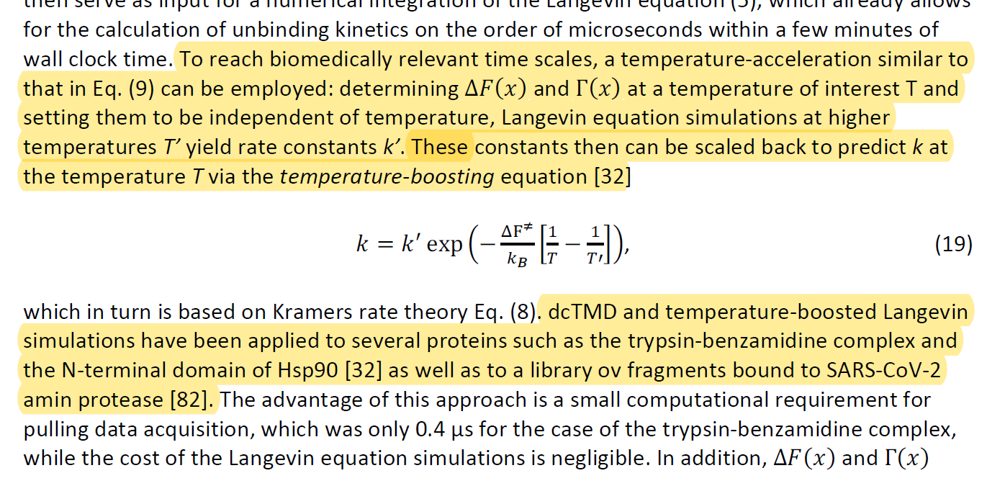
1.2
2. Biased MD
Steffen Wolf
可以根据这个公式进行权重
MFPT

