Slide 1
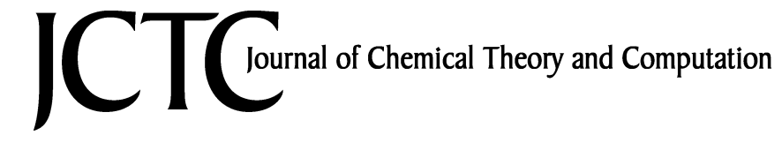
文献汇报：周兆寅
中国科学院上海药物研究所
2021年04月16日

Slide 2
CONTENT
About the Author
Methods
3. Results and Discussion
4. Summary

Slide 3

1.1 The CHEATHAM Group
THOMAS E. CHEATHAM, III
Departments of Medicinal Chemistry, University of Utah,
Director of Center for High Performance Computing
Salt Lake City, Utah 84112, United States
molecular dynamics, analysis methodologies
the reliable representation of nucleic acid systems in solution
characterize RNA structure and force fields through simulation
understand how ligands alter receptor structure upon binding
explore methods to mine more information from the simulation data
Notes:
Thomas E. Cheatham, III and Lab | College of Pharmacy | University of Utah Health

Slide 4
CONTENT
About the Author
Methods
3. Results and Discussion
4. Summary

Slide 5
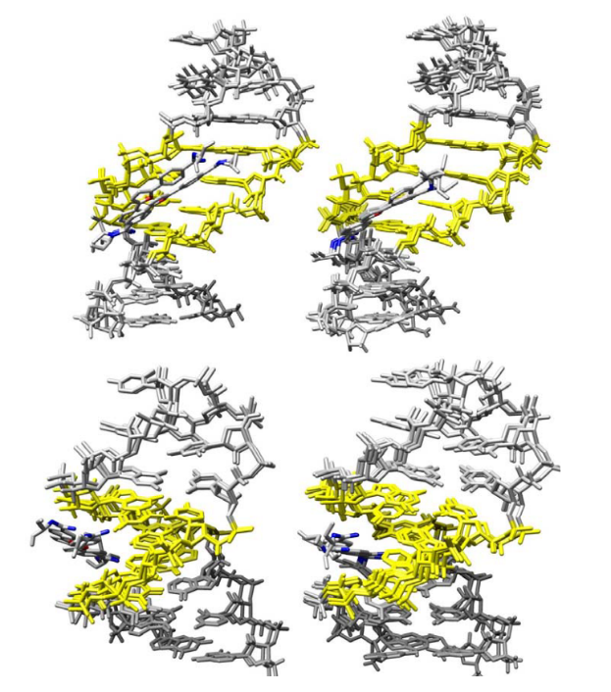
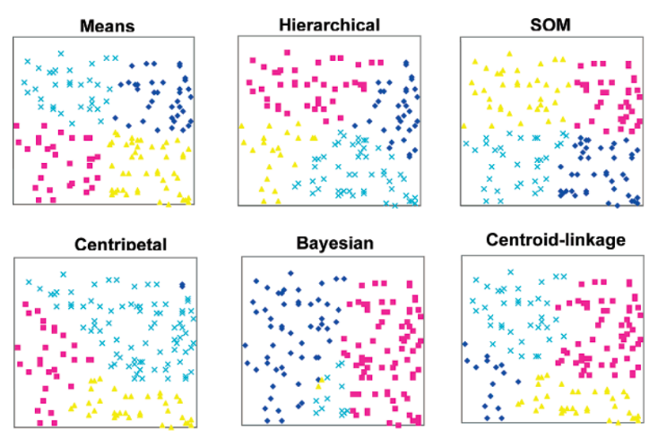
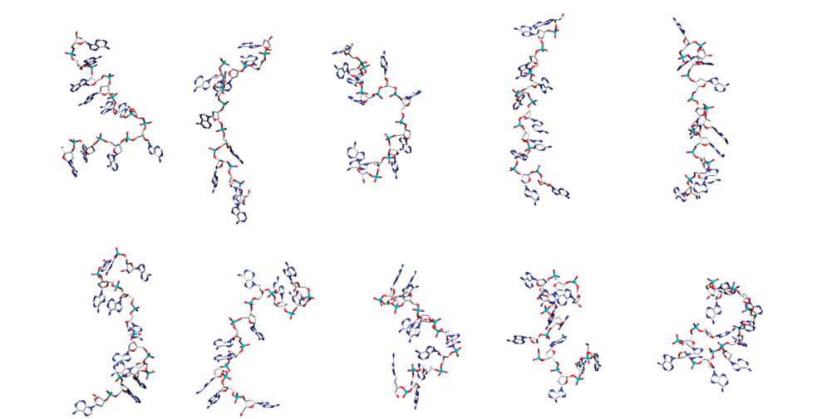
2. Methods
polyA Single Strand
Points in the 2D Plane
Artificial MD Data: Five Equally Sized and
Distinct Clusters( 5 *100ps)
Real MD Data: Simulation of Drug-DNA
Interaction
Artificial MD Data: Five Differentially
Sized Clusters (2, 15, 50, 100, and 333 configurations)

Slide 6
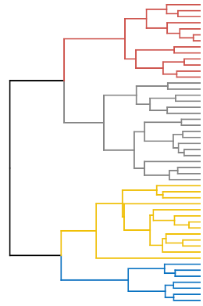
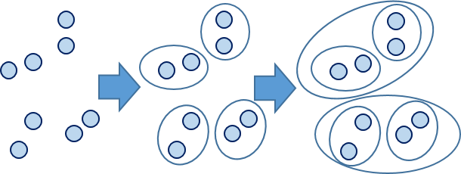
2. Methods
4 categories | 11 different clustering algorithms
top-down splitting | hierarchical
bottom-up aggregating | single-linkage edge joining
 | centroid-linkage
 | average-linkage
 | complete-linkage
 | centripetal
 | centripetal-complete
refinement | Means
 | Bayesian
 | self-organizing maps
tree algorithm | COBWEB
Notes:
凝聚法分层聚类

Slide 7




2. Methods（Clustering Metrics）
the Davies-Bouldin index (DBI) the pseudo F-statistic(pSF)
A / B
A = （T – P）/（G-1），
B = P / （n-G）。
n 是点数，G 是聚类数
T 是与全数据质心的总距离
P 是与聚类质心的距离之和
反映“紧密性”，本质上是组间平均平方和与组内平均平方和的比率。高值是好的
分散度：
距离值：
相似度：
值， 值越小，聚类效果越好
Notes:
分散度的值Si：表示第i个类中，度量数据点的分散程度; Xj表示第i类中第j个数据点；Ai表示第i类的中心；Ti表示第i类中数据点的个数
+

Slide 8
CONTENT
About the Author
Methods
3. Results and Discussion
4. Summary

Slide 9
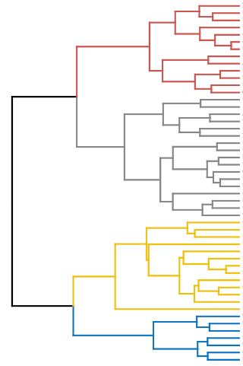
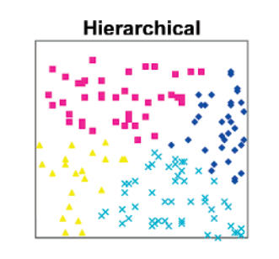
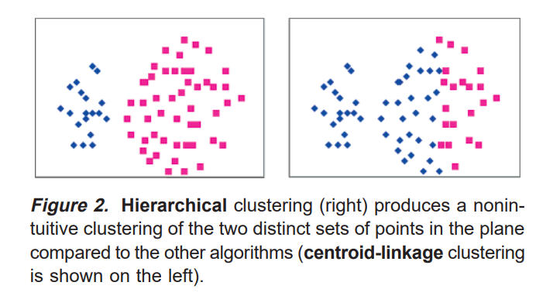
3.1 top-down splitting (divisive)
1. Assign all points to a single cluster.
2. Calculate the diameter of each of the clusters.
3. Split the cluster with the largest.
4. If the desired cluster count has been reached, stop; otherwise, go to Step 2.
sensitive to extreme points
cannot produce concave clusters
fast
Notes:
凝聚法分层聚类

Slide 10
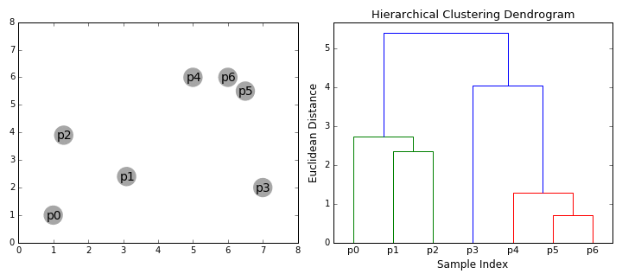
3.2 bottom-up aggregating
categories | 6 different clustering algorithms
bottom-up aggregating | single-linkage edge joining
 | centroid-linkage
 | average-linkage
 | complete-linkage
 | centripetal
 | centripetal-complete
Notes:
凝聚法分层聚类

Slide 11
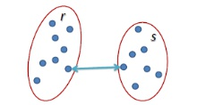
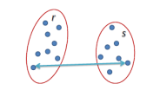
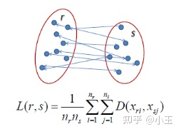
3.2 bottom-up aggregating
categories | 6 different clustering algorithms
bottom-up aggregating | single-linkage edge joining
 | centroid-linkage
 | complete-linkage
 | average-linkage
Assign each point to its own cluster.
Calculate in different ways and aggregate.
If the desired cluster count has been reached, stop; otherwise go to Step 2.
L(r,s)=min(D(X_{ri},X_{sj}))
L(r,s)=max(D(X_{ri},X_{sj}))
Notes:
凝聚法分层聚类

Slide 12
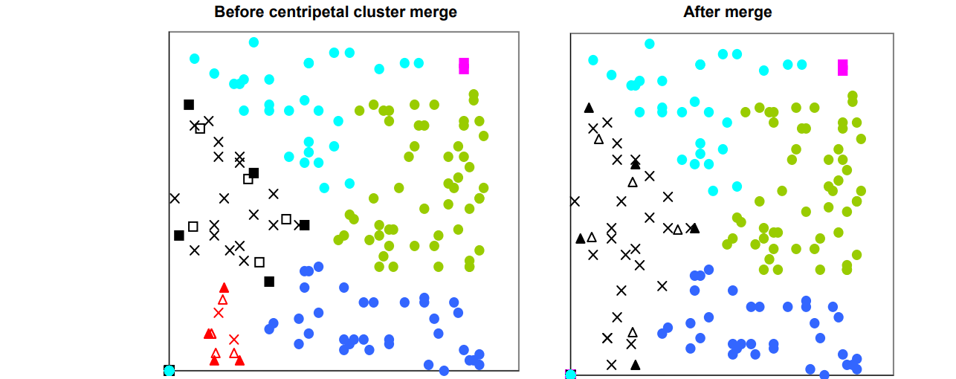
3.2 bottom-up aggregating (Centripetal)
categories | 6 different clustering algorithms
bottom-up aggregating | centripetal
 | centripetal-complete
Notes:
凝聚法分层聚类

Slide 13
3.2 bottom-up aggregating
categories | 6 different clustering algorithms
bottom-up aggregating | centroid-linkage
 | average-linkage
 | centripetal
 | complete-linkage
 | centripetal-complete
 | single-linkage edge joining
1. have a tendency to produce outlier or singleton clusters
2. Careful choice of cluster count is one way to mitigate this sensitivity
1. Give consistently good results as quantified by DBI and pSF.
2. They can produce clusters of varying sizes and possibly concave shapes.
1. It tends to produce a larger minimum cluster size.
2. It’s parameters may be of help to improve cluster quality.
Avoid producing singleton clusters.
2. The resulting clusters tend to be small.
Can handle clusters of differing sizes
Fragile and sensitive
Notes:
凝聚法分层聚类

Slide 14
3.3 refinement
categories | 3 different clustering algorithms
refinement | means
 | Bayesian
 | self-organizing maps
tree algorithm | COBWEB
random
K-means
results become poor for high cluster counts.
Need be repeated many times with new random seeds.
1. It is highly dependent on the order of the points.
2. The variations between multiple COBWEB runs are relatively large.
Notes:
SOM is a form of artificial neural network.
Randomly assign the values of attributes for each cluster (map node).
Train the underlying map (a simple linked loop) with all points.
Repeat the training a lot of times.
assign the points to the closest trained cluster.

Slide 15
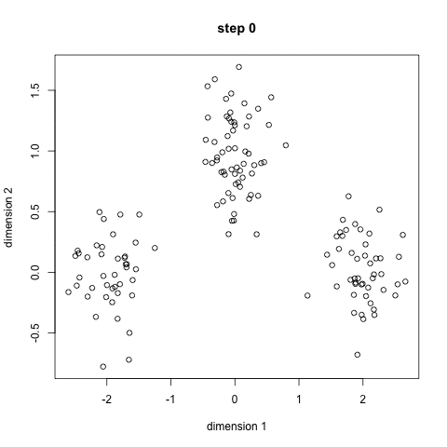
3.4 k-means
牧师—村民模型：
四个牧师去郊区布道，一开始牧师们随意选了几个布道点，并且把这几个布道点的情况公告给了郊区所有的村民，于是每个村民到离自己家最近的布道点去听布道会。
听课之后，大家觉得距离太远了，于是每个牧师统计了一下自己的布道会上所有的村民的地址，搬到了所有地址的中心地带，并且向村民们更新了自己的布道点的位置。
牧师们的每一次移动不可能离所有人都更近，有的村民发现A牧师移动以后自己还不如去B牧师处听课更近，于是每个村民又去了离自己最近的布道点……
就这样，牧师每个礼拜更新自己的位置，村民根据自己的情况选择布道点，最终稳定了下来。
我们可以看到该牧师的目的是为了让每个村民到其最近中心点的距离和最小。
Notes:
凝聚法分层聚类

Slide 16
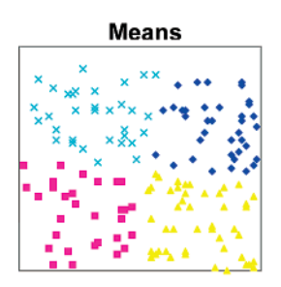
3.4 k-means
牧师—村民模型：
四个牧师去郊区布道，一开始牧师们随意选了几个布道点，并且把这几个布道点的情况公告给了郊区所有的村民，于是每个村民到离自己家最近的布道点去听布道会。
听课之后，大家觉得距离太远了，于是每个牧师统计了一下自己的布道会上所有的村民的地址，搬到了所有地址的中心地带，并且向村民们更新了自己的布道点的位置。
牧师们的每一次移动不可能离所有人都更近，有的村民发现A牧师移动以后自己还不如去B牧师处听课更近，于是每个村民又去了离自己最近的布道点……
就这样，牧师每个礼拜更新自己的位置，村民根据自己的情况选择布道点，最终稳定了下来。
我们可以看到该牧师的目的是为了让每个村民到其最近中心点的距离和最小。
Notes:
凝聚法分层聚类

Slide 17
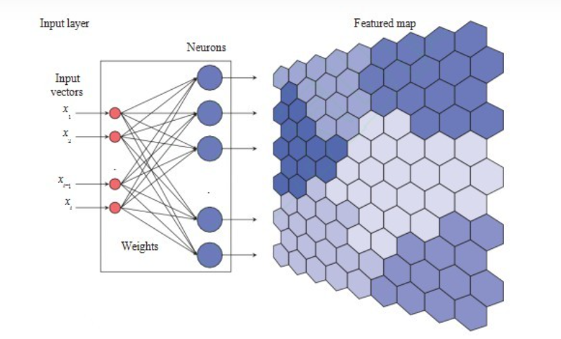
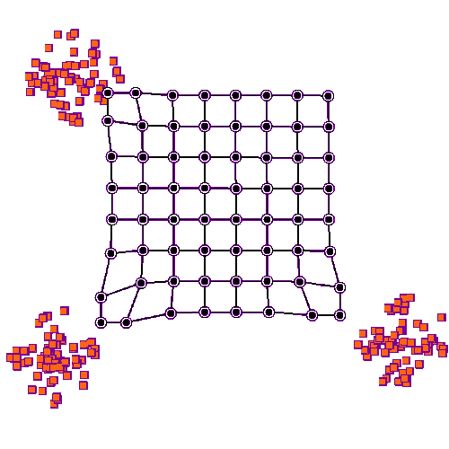
3.5 refinement (self-organizing maps)
SOM is a form of artificial neural network.
Randomly assign the values of attributes for each cluster (map node).
Train the underlying map (a simple linked loop) with all points.
Repeat the training a lot of times.
Assign the points to the closest trained cluster.
Notes:
凝聚法分层聚类

Slide 18
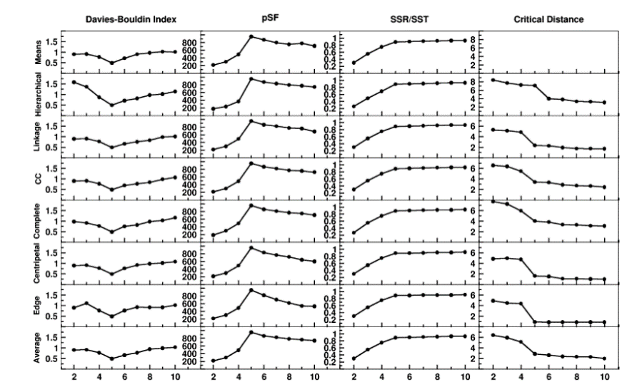
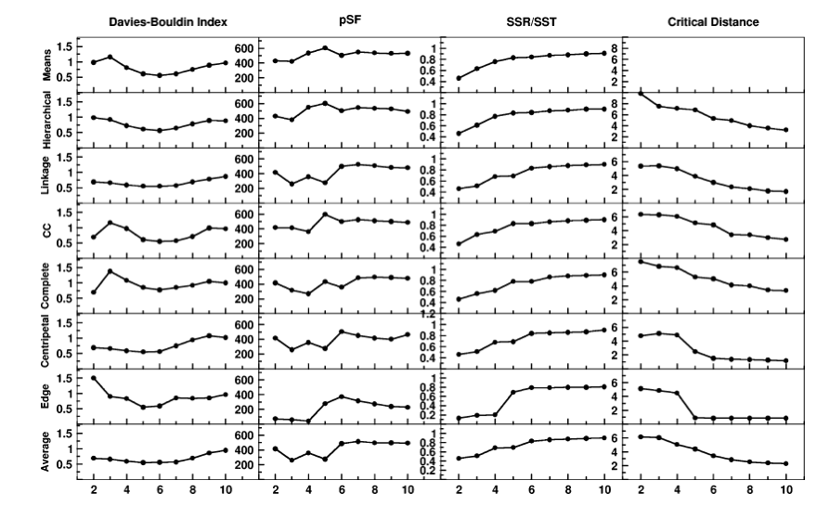
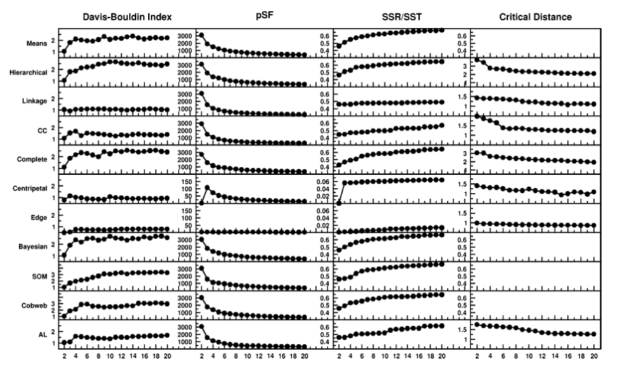
3.6 results
DBI
pSF
DBI
pSF
DBI
pSF
Artificial MD Data:
Five Equally Sized Clusters
Artificial MD Data:
Five Differentially Sized Clusters
(2, 15, 50, 100, and 333 configurations)
Real MD Data:
Simulation of Drug-DNA
Interaction
Notes:
凝聚法分层聚类

Slide 19
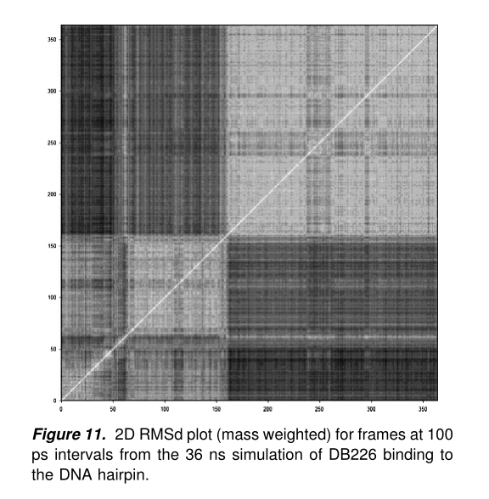
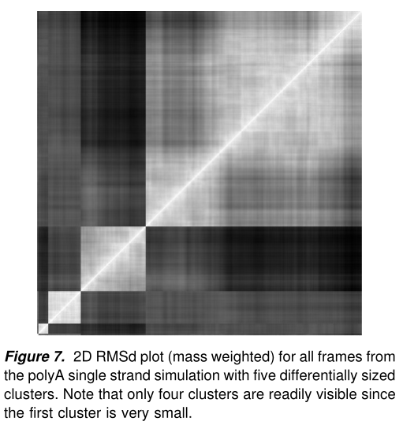
3.6 results
Notes:
凝聚法分层聚类

Slide 20
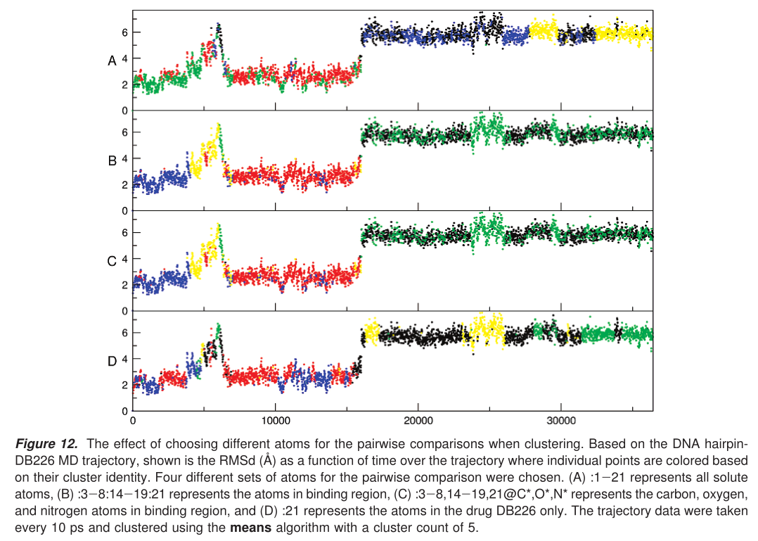
3.6 results
The choice of atoms for the pairwise comparisons
when clustering is important.
Notes:
凝聚法分层聚类

Slide 21
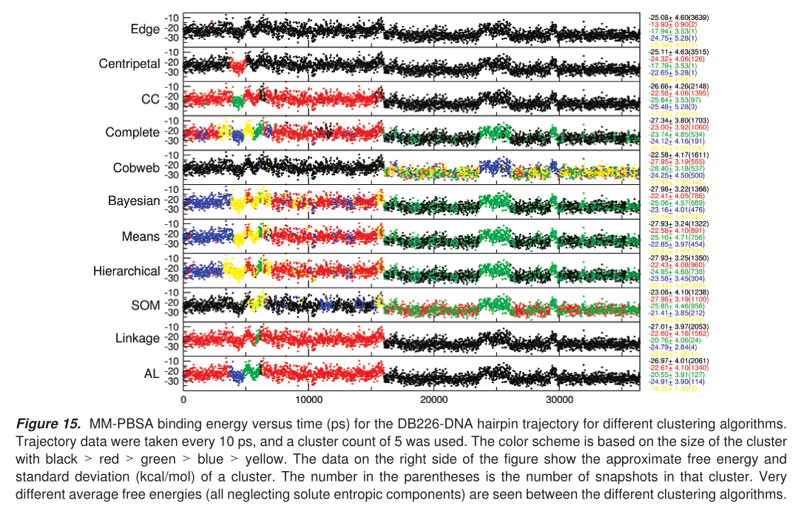
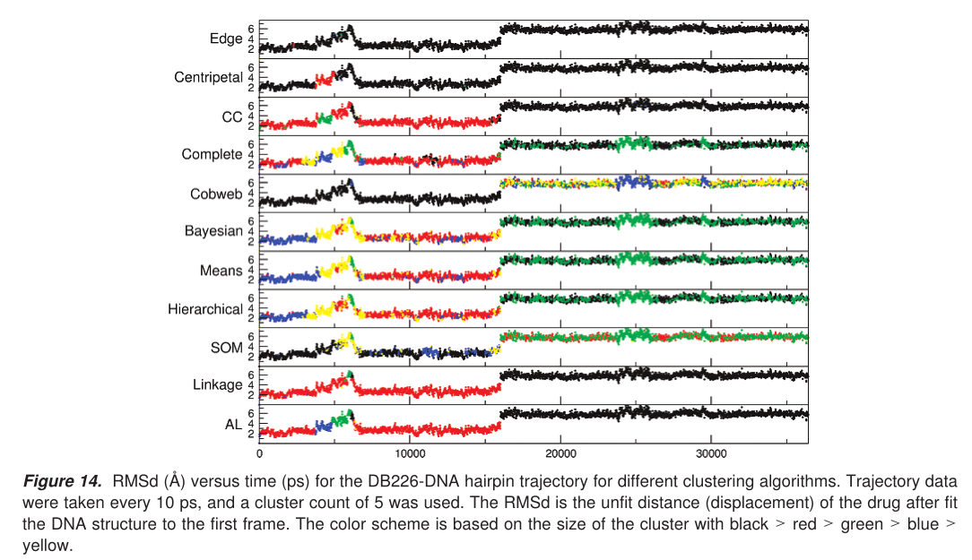
3.6 results
Notes:
凝聚法分层聚类

Slide 22
CONTENT
About the Author
Methods
3. Results and Discussion
4. Summary

Slide 23
5. Summary
Various algorithms show widely different behaviors
The performance of a given algorithm is strongly dependent on the choice of cluster count and the choice of atoms for the pairwise comparison
Evaluation of the relative performance was made possible through visualization of the results and also through the exploration of various metrics defining the performance.
Specifically, low DBI values and high pSF values signal better clustering.
In order to more efficiently handle very large data sets, a sieving approach was introduced where only a portion of the data is initially clustered, and then the remaining data are added to existing clusters. 6. Overall, the best performance was observed with the average-linkage,means, and SOM algorithms. 7. If the cluster count is not known in advance, consider hierarchical or average-linkage.

Slide 24
THANK YOU

