Slide 1
Kinetics of Drug Binding and Residence Time
Mattia Bernetti,¹ Matteo Masetti,¹ Walter Rocchia,² and Andrea Cavalli^{1,3}
Annu. Rev. Phys. Chem. 2019. 70:173–201
文献汇报：罗睿童
中国科学院上海药物研究所
2023年03月09日

Slide 2
CONTENT
1. About the Author
2. Background
3. Methods
4. Results and Discussion
5. Summary
Notes:
The Variationally Enhanced Sampling (VES) method [1] is born as an evolution of Metadynamics, and shares with it the idea of enhancing the sampling by biasing some collective variables which characterize the system under investigation. It reduces the procedure of finding the free energy surface to the problem of minimizing the following convex functional:

Slide 3
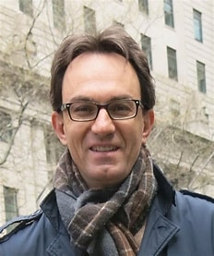
1.1 Andrea Cavalli
Andrea Cavalli
Computational Structural Biology
Department of Pharmacy and Biotechnology, University of Bologna
Computational Sciences Domain, Istituto Italiano di Tecnologia
CHESHIRE method
Enabled the first accurate determination of the native state of proteins using NMR chemical shifts and the structural characterization of the intermediate state of a protein
RESEARCH INTEREST
The development of computational methods for the determination of the structure of folded and misfolded states of proteins from minimal sets of experimental data
Notes:
安德里亚·卡瓦利

Slide 4
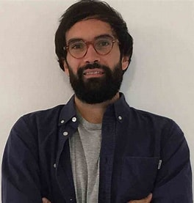
1.2 Mattia Bernetti
Mattia Bernetti
2008 Degree in Chemistry and Pharmaceutical Technologies
2014 Biotechnological and Pharmaceutical Sciences
2018 Dept. of Pharmacy and Biotechnology
2018 Molecular and Statistical Biophysics Group
2021 Computational and Chemical Biology
Notes:
那不勒斯大学“费德里科二世”(意大利)
n particular, it merits to be mentioned the use of the path collective variables to study ligand binding to COXs (5) and a recent work, published on PNAS (6), where he presents a new method, called funnel-metadynamics, to sample the ligand binding to its molecular target with an accurate estimation of its binding free energy. An evolution of the method, recently reported on PNAS (7), allows retrieving accurate estimates of the ligand binding kinetics and defining the rate limiting steps in the lugand/target recognition process.

Slide 5
CONTENT
1. About the Author
2. Background
3. Methods
4. Results and Discussion
5. Summary

Slide 6
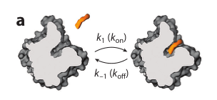
2.1 Residence Time
From a mechanistic standpoint, the process of a drug binding to its biological target may be considered a multistep reaction mechanism.
The time a drug spends in contact with its biological target is now considered a key parameter for optimization because there is some evidence that it can predict drug efficacy in vivo.
residence time = 1/k_{off}
Notes:
从机理的角度来看，药物与生物靶标结合的过程可以被认为是一个多步骤反应机制。(a)药物与其生物靶标的结合是由一个单一的一步过程描述的，其特征是结合和解离速率常数k1(kon) and k−1 (koff)。(b)药物结合过程的更一般描述，其中靶点可能发生蛋白质构象变化和/或异构化。

Slide 7
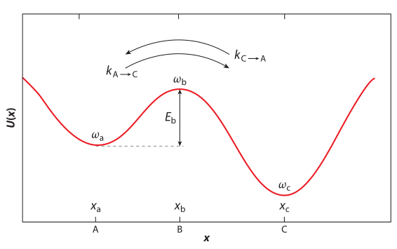
2.2 Theoretical Background
Transition State Theory
Kramers Rate Theory
Path-Sampling Methods
Path-sampling methods rely on the idea that rare events per se are not slow, just very infrequent.
One of the shortcomings of TPS is that it requires knowledge of the state phase density and an initial reactive trajectory, which may not be realistically achievable.
Notes:
过渡态理论，也称为活化复合体理论或绝对反应速率理论，把化学反应和其他过程视为由组成原子和分子的相对位置和势能的连续变化而进行的处理。在原子或分子的初始排列和最终排列之间的反应路径上，存在一个势能最大的中间构型。因此，过渡态的意义可以简单地解释为，当两个具有确定分子排列的反应物进行化学反应时，在分子或原子的初始和最终排列之间达到一个中间反应状态，其中观察到最大的势能。这种具有最大势能的原子或分子的特殊中间构型称为活化络合物，其状态被定义为过渡态。在这些过程中，反应物的原子和分子的相对位置发生连续变化，导致反应的初始阶段和最终阶段之间的势能发生变化。这是传输系数，它解释了那些反应轨迹，这些轨迹重新穿过过渡态，并返回而不以生成物状态结束。因此，它的值总是在0到1之间。假设κ为1(这是一个常见的假设)，则可以恢复过渡态理论(TST)速率kTST。路径采样方法依赖于罕见事件本身并不慢，只是非常不频繁的想法。
因此，这些方法只把计算精力集中在过渡事件上。
他们通过收集代表性路径来做到这一点，这些路径构成了过渡路径集合(TPE)

Slide 8
CONTENT
1. About the Author
2. Background
3. Methods
4. Results and Discussion
5. Summary

Slide 9
CONTENT
Thermodynamics parameters
3.1 Experimental methods
affinity toward specific molecular targets.
Kinetic parameters
the optimization of the association and dissociation rates
3.2 Computational methods
the ultimate goal
molecular simulations
model the behavior of biomolecules
displaying pharmaceutical relevance

Slide 10
3.1.1 Labeled Methods
Radio- and spectroscopic labeling are the main options included in this first class.
With the rare exception of ligands with an intrinsic feature that provides the label, a probe must be joined to the molecule under consideration.
Methods | Sorts | Advantages | Disadvantages
Radiometric binding assays | The direct approach | Straightforward | Label each ligand under consideration, which is expensive and labor intensive Not all drugs make good radioligands low-throughput
 | Indirect methods | only one radiolabeled species is required to carry out the assay making larger-scale applications feasible | /
Fluorescent tags assays | the change in a fluorescence property (intensity or polarization) | / | /
 | energy transfer | / | /
Notes:
无线电和光谱标记是包括在这一类的主要选项。放射性标签本质上是我们想要追踪的分子中放射性同位素的存在。在它们衰变到更稳定的状态时，这些同位素会发出辐射，可以通过检测这些辐射来监测被标记的物种。在辐射结合分析中，配体通常被标记，以跟踪它们与分子目标相互作用的时间过程。在直接方法中，随着时间的推移，与感兴趣的受体结合的放射性配基的浓度被跟踪，允许测量其关联和解离速率常数kon和koff(31)。配体用荧光标签标记在基于光谱的方法。在吸收一定波长的电磁辐射后，荧光团以特征的，通常较长的波长值发射。当辐射源停止时，辐射几乎立即停止。

Slide 11
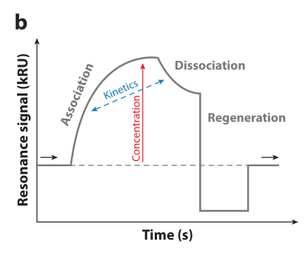
3.1.2 Label-Free Techniques
Since ligands are typically analyzed in series, throughput is typically confined.
While effective, the above approaches require either dedicated instruments or demanding setups.
Association phase
(the detected signal increases, until a
steady state is reached)
Dissociation phase
(a decrease in the signal is observed)
Notes:
可以实时观察到折射率的变化。因此，当固定目标结合配体分子时，折射率的增加被检测到。从关联阶段开始，其中包含配体的样品被注入仪器。随着化合物的脉冲持续，检测到的信号增加，直到达到稳定状态。这一步之后是解离阶段，在此期间样品注入停止，并被连续的缓冲液流动所取代。结果，配体从表面结合复合物解离发生，并观察到信号的减少。从记录的数据中可以建立随时间变化的响应单元(RU)曲线，从中可以获得亲和性和动力学性质。

Slide 12
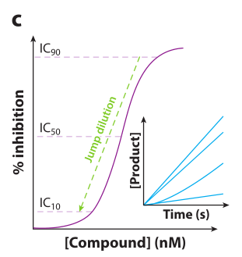
3.1.3 Assays Based on Enzyme Activity
The short assay development time is a strength of this approach.
The analysis of the progress curve analysis is effective, and particularly reliable, when used to characterize compounds with slow dissociation rates.
Parameters such as spectroscopic absorbance increase or decrease
Monitoring substrate consumption or product formation due to the enzymatic reaction
Determine the activity of a specific enzyme and use them to retrieve kinetic information
Notes:
其斜率提供了关于抑制剂失活机制是可逆还是不可逆的信息。此外，曲线的初始部分的曲率取决于化合物的停留时间

Slide 13
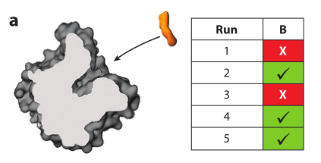
3.2.1 Brute-Force MD
Because of its reliance upon computational power alone
Advantages | Application
For small fragments, the weaker interactions established with the protein allow several unbinding events to be achieved within reasonable timescales. | The association of dasatinib and PP1 to the Src kinase through simulations in the low microsecond regime (reproducing the crystallographic pose) Binding of the transition state analog DADMe-imucillin-H to purine nucleoside phosphorylase was also explored via brute-force MD
(a) Determination of kon from the number of spontaneous binding events
Notes:
MD模拟可以在一段时间内以原子级别的细节捕获系统的所有配置。给定一个合适的势能函数，分子系统在MD框架内通过对模型中所有原子的牛顿运动方程进行积分而在时间上演化.我们进行积分的时间跨度称为时间步长。然后，通过对一系列时间步重复此过程，我们得到了系统的许多配置作为时间的函数。这被称为MD轨迹。不幸的是，我们最感兴趣描述的过程，即蛋白质配体(un)结合，是缓慢和罕见的。这些事件发生在当前硬件架构上的传统MD模拟(以下称为“普通MD”)难以访问的时间尺度上。在这种情况下，如果可以获得足够的统计量，可以通过将单个指数(一阶动力学所要求的)拟合到停留时间相关函数来获得解离速率常数，而停留时间相关函数又可以通过对观测到的解绑定时间(85)的概率分布p(tunb)进行积分来获得:

Slide 14
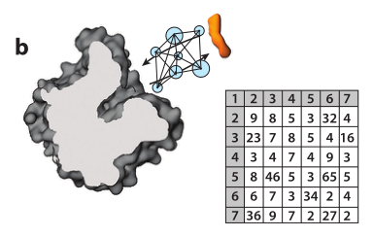
3.2.2 MSM
Information from a greater number of shorter trajectories can be aggregated to construct a Markov state model (MSM)
Advantages | Disadvantages | Application
1)几个MD模拟可以并行运行,更易于管理。 2)可以识别需要额外采样的微观状态，从而指导对构型空间的详尽探索(adaptive sampling) | Human supervision is typically required to carry out resampling. | The serine protease trypsin and reversible competitive inhibitor benzamidine Trypsin-benzamidine system
Notes:
MD模拟可以在一段时间内以原子级别的细节捕获系统的所有配置。给定一个合适的势能函数，分子系统在MD框架内通过对模型中所有原子的牛顿运动方程进行积分而在时间上演化.我们进行积分的时间跨度称为时间步长。然后，通过对一系列时间步重复此过程，我们得到了系统的许多配置作为时间的函数。这被称为MD轨迹。不幸的是，我们最感兴趣描述的过程，即蛋白质配体(un)结合，是缓慢和罕见的。这些事件发生在当前硬件架构上的传统MD模拟(以下称为“普通MD”)难以访问的时间尺度上。在这种情况下，如果可以获得足够的统计量，可以通过将单个指数(一阶动力学所要求的)拟合到停留时间相关函数来获得解离速率常数，而停留时间相关函数又可以通过对观测到的解绑定时间(85)的概率分布p(tunb)进行积分来获得:

Slide 15
3.2.3 BD
Advantages | Disadvantages | Application
1)减少了计算负担,因为只有溶质是在原子级别描述的，而溶剂是通过适当的溶剂化隐式模型处理的 2)通过忽略内部自由度，允许更大的时间步长，仿真性能显著提高 3)包含在多尺度框架中，在模拟域的相关区域保持原子分辨率 | 对于较小规模的事件，例如溶质的局部重排，通常也会丢失分辨率。 | The natural substrate sialic acid and the inhibitor oseltamivir to the neuraminidase glycoprotein
Notes:
在朗之万动力学中，溶剂没有被明确地包括在内，但流体动力学对溶质的影响是通过γ和R(t)来模拟的，γ是描述介质粘度的摩擦系数，R(t)是一种随机力，它以随机方式搅动物体。在γ = 0的极限下，在没有随机力作用于溶质分子的情况下，可以恢复牛顿运动方程。在无限γ的极限下，设想了一个扩散状态，其中溶质粒子的运动是缓慢的，惯性记忆很快就会丢失。这导致了过阻尼状态的近似朗之万方程，或布朗动力学(BD)

Slide 16
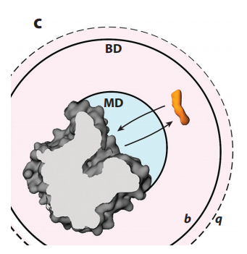
3.2.3 Multiscale Modeling
Recently developed multiscale methods combine the use of MD and BD.
treat the diffusive encounter of the involved species
model their behavior once they are in close proximity
Advantages | Application
1)提高效率 | study the association with binding of the inhibitors oseltamivir and zanamivir to H1N1 neuraminidase trypsin-benzamidine system
What about other combinations?

Slide 17
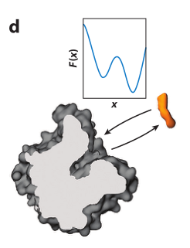
3.2.4 FES
Advantages | Application
1)全面描述所研究的过程（定性和定量） 2)基于FES的偏置方法是计算密集型的 3)含有严重误差，主要影响势垒估计 | The binding process of a short peptide substrate associating with wild-type HIV-1 protease
Notes:
但缓慢过程的采样仍然是一个关键的挑战。
因此，另一类基于md的方法被引入，以改进在完全原子级别上对构型空间的探索，同时尽可能地保持计算工作量(125)。

Slide 18
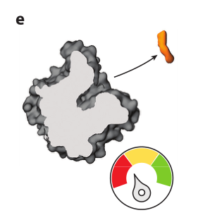
3.2.5 Biased Rates Approaches and Time-Rescaling Strategies
Application
Archetypal trypsin-benzamidine system
Notes:
但缓慢过程的采样仍然是一个关键的挑战。
因此，另一类基于md的方法被引入，以改进在完全原子级别上对构型空间的探索，同时尽可能地保持计算工作量(125)。

Slide 19
3.2.6 RAMD
RAMD used mild random forces to promote the egress of ligands from their binding sites. When used to calculate relative residence times, this approach is known as τ-RAMD. rank drug candidates by their computed residence time.
Application
Kokh et al. recently correctly ranked the residence time of a large (70 compounds) set of diverse drug-like molecules bound to the HSP90 protein. This strategy obtained a good correlation (R² = 0.86) between computed and experimental residence times.
Notes:
但缓慢过程的采样仍然是一个关键的挑战。
因此，另一类基于md的方法被引入，以改进在完全原子级别上对构型空间的探索，同时尽可能地保持计算工作量(125)。

Slide 20
CONTENT
1. About the Author
2. Background
3. Methods
4. Results and Discussion
5. Summary

Slide 21
4. Results and Discussion
trypsin-benzamidine
Methods | Results
MSM | k_{on} = 4.4 × 10⁸ M⁻¹ s⁻¹ and k_{off} = 2.8 × 10⁴ s⁻¹
multiscale | k_{on} = 2.1 × 10⁷ M⁻¹ s⁻¹，k_{off} = 83 s⁻¹
Biased Rates Approaches and Time-Rescaling Strategie | The direct computation of k_{off} = 9.1 s⁻¹. Using the computed k_{off} together with the free-energy difference of binding from previous works, an indirect calculation of k_{on} =1.18 × 10⁷ M⁻¹ s⁻¹ was pursued.
experimentally measured | k_{on} = 2.9 × 10⁷ M⁻¹ s⁻¹ and k_{off} = 600 s⁻¹
Notes:
一方面，有快速的方法来对化合物进行排名，尽管准确确定绝对停留时间值可能需要大量的训练集和基于可用实验数据的稳健相关性。尽管如此，这些方法可以帮助区分快速和缓慢的粘合剂，并在化学合成活动中优先考虑化合物。另一方面，有更准确的方法来预测药物结合的动力学。然而，这些方法可能需要数周或数月的计算和人力来确定单个化合物的绝对停留时间值。尽管这些方法具有很高的准确性，但它们与药物发现计划不兼容，后者需要在速度和准确性之间进行合理的权衡。

Slide 22
CONTENT
1. About the Author
2. Background
3. Methods
4. Results and Discussion
5. Summary

Slide 23
5. Summary
fast methodologies for ranking compounds
accurate approaches for predicting the kinetics of drug binding
require a reasonable tradeoff between speed and accuracy
a combination of different sampling methods to estimate residence time
find the right compromise between speed and accuracy
Notes:
一方面，有快速的方法来对化合物进行排名，尽管准确确定绝对停留时间值可能需要大量的训练集和基于可用实验数据的稳健相关性。尽管如此，这些方法可以帮助区分快速和缓慢的粘合剂，并在化学合成活动中优先考虑化合物。另一方面，有更准确的方法来预测药物结合的动力学。然而，这些方法可能需要数周或数月的计算和人力来确定单个化合物的绝对停留时间值。尽管这些方法具有很高的准确性，但它们与药物发现计划不兼容，后者需要在速度和准确性之间进行合理的权衡。

Slide 24
6. Thinking
1.计算热力学和动力学的方法这么多，我应该如何选择和学习？哪些是我们比较经常用到的？
2.当构象是动态变化时，k_{off}=k₋₁？
3.Dynamics docking和Brute-force sampling有什么关系？
4.为什么选择将MD与BD结合？以及In the context of binding processes, why is the general idea to use less demanding BD to treat the diffusive encounter of the involved species, while switching to MD to model their behavior once they are in close proximity？如何理解less demanding BD？
Notes:
1.计算热力学和动力学的方法这么多，我应该如何选择学习？哪些是我们比较经常用到的？2.当构象是动态变化时，tao=？3.Dynamics docking和Brute-force sampling有什么关系？4.In the context of
binding processes, the general idea is to use less demanding BD to treat the diffusive encounter
of the involved species, while switching to MD to model their behavior once they are in close
proximity.

Slide 25
THANK YOU FOR YOUR ATTENTION

Slide 26
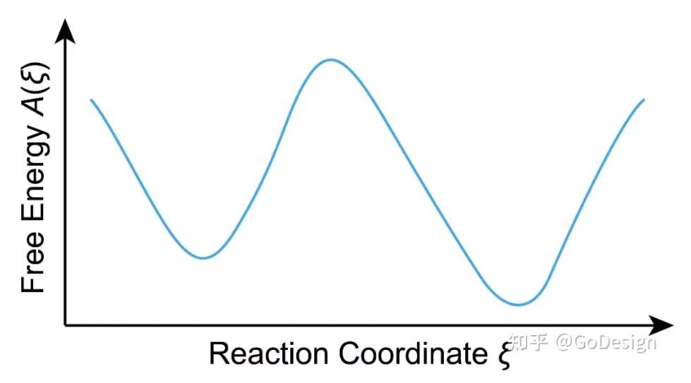
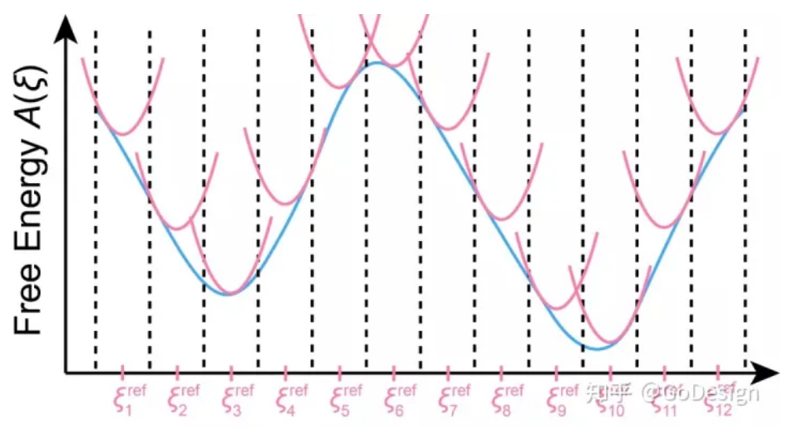
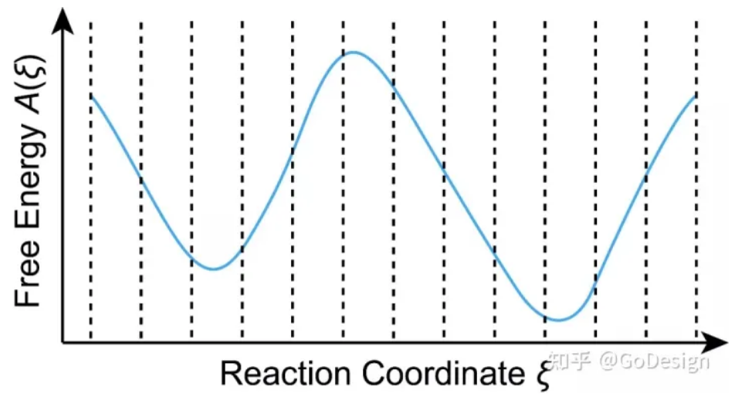
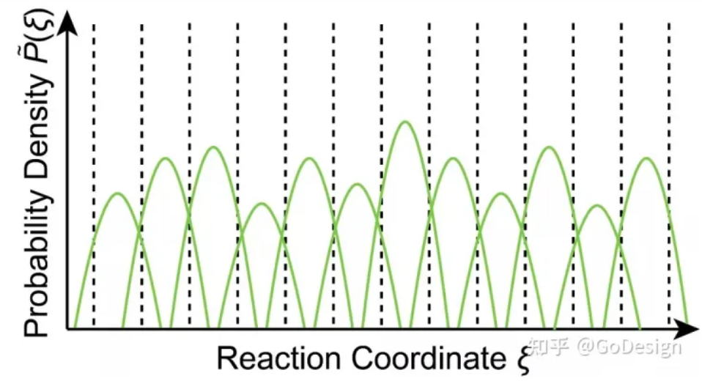
Umbrella Sampling

