Slide 1
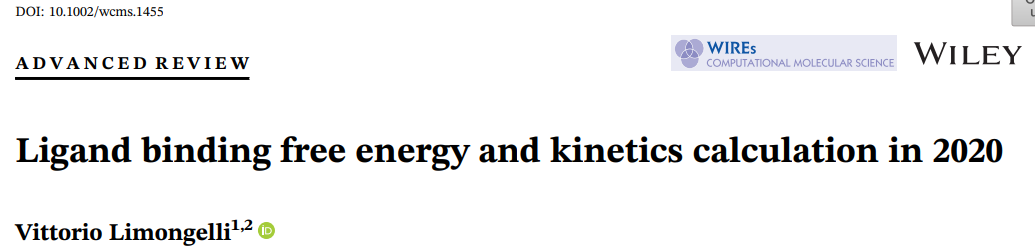
韩子涧
2023年3月9日

Slide 2
Content
1.Introduction
2.Methods for LPB thermodynamics
3. Methods for LPB kinetics
4.Summary

Slide 3
Content
1.Introduction
2. Methods for LPB thermodynamics
3. Methods for LPB kinetics
4.Summary
1.1 About the Author
1.2 Thermodynamics and kinetics
1.3 Ligand/protein binding(LPB)

Slide 4

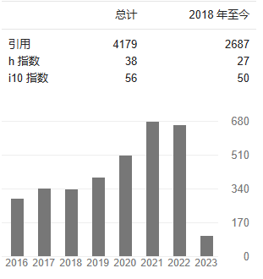
1.1 Introduction-About the Author
USI Lugano (Switzerland) / University of Naples (Italy)

Slide 5
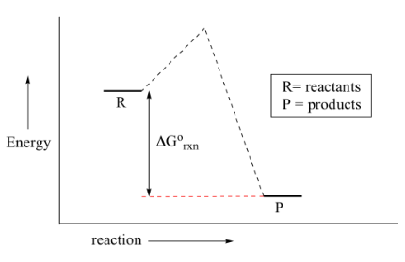
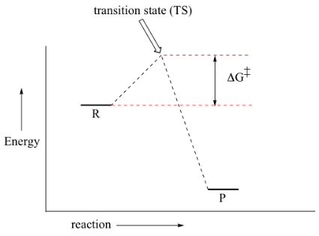


1.2 Introduction-thermodynamics & kinetics
Thermodynamics can tell you only that a reaction should go because the products are more stable.
K is independent of the reaction mechanism.
Kinetics, on the other hand, can tell you how fast the reaction will go but doesn't tell you anything about the final state of things once it gets there.
Rate constant changes with T and with catalyst. A catalyst would change the activation energy for the rate-determining step.
Thermodynamics and Kinetics (stanford.edu)

Slide 6
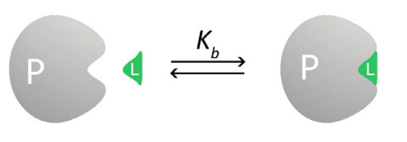






1.3 Introduction-Ligand/protein binding (LPB)
LPB is a dynamic process.
Ligand: fully solvated state to binding site and reverse
Proteins: different conformations before interaction or
specific conformations upon ligand binding
Ligands designed to improve their interaction with the binding site's aminoacids might turn out to be inactive due to the poor binding kinetic profile.
At equilibrium condition:
thermodynamics
kinetics

Slide 7
Content
1.Introduction
2. Methods for LPB thermodynamics
3. Methods for LPB kinetics
4.Summary
2.1 Docking methods
2.2 End-state methods:
Linear Interaction Energy
MM-PBSA/MM-GBSA
2.3 Alchemical free-energy perturbation methods:
Free Energy Perturbation
2.4 Physical pathway methods(sampling):
Metadynamics
Funnel-Metadynamics
Accelerated MD
Umbrella sampling
Steered MD
Weighted ensemble

Slide 8
2.1 Docking methods
User first defines a region in the target structure that includes the binding site. Then, the docking algorithm simulates all the possible binding conformations of the ligand within the protein's binding site using different sampling methods, such as systematic search, Monte Carlo (MC) and genetic algorithms.
At the end of the calculation, the docking program ranks all the ligand binding conformations by means of a scoring function.

Slide 9
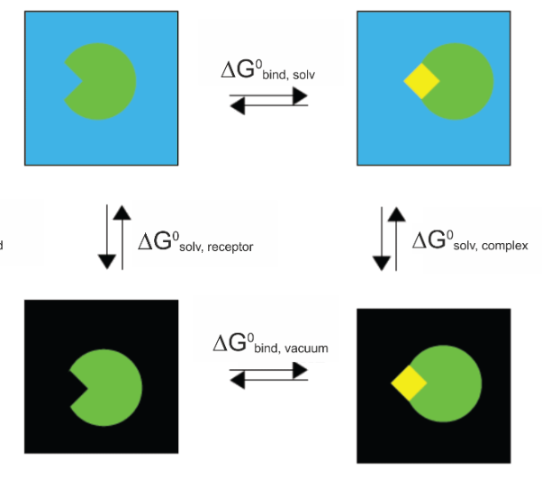


2.2 End-state methods: MM-PBSA/MM-GBSA
The majority of the energy contributions come from solvent-solvent interactions and their fluctuations are larger than binding energy.
Where,
A.
Every term in A is calculated through:
B.
The first term in B is calculated through:
Poisson-Boltzmann(PB) or Generalized Born(GB) equation
The second term in B is calculated through:
fast assessment
not accurate enough
MM-PBSA (ambermd.org)

Slide 10
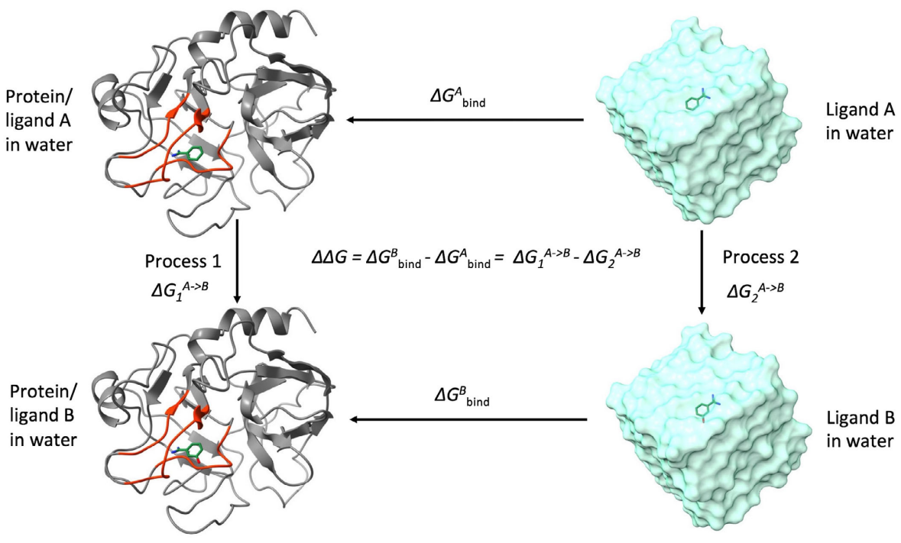

2.2 Free-energy perturbation methods
Perturbation: small changes in system → sum of smaller changes
where, ΔF: free-energy difference U: potential energy
relatively accurate
highly dependent on ergodic sampling （各态经历）
restrained in similar ligands

Slide 11
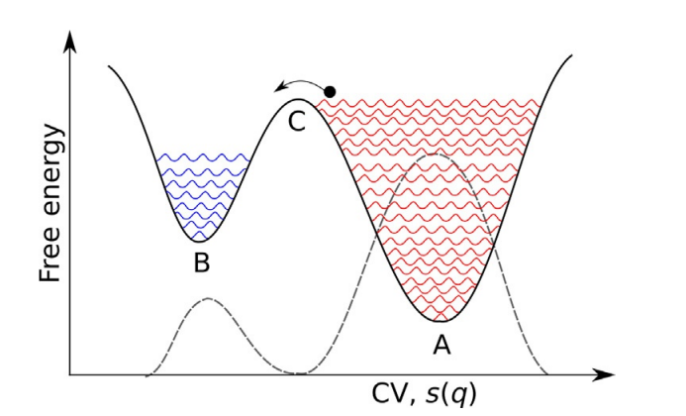



Supplementary: Metadynamics
Collective variable (CV): 用来描述系统的最小独立参数，即广义坐标（或自由度，反应坐标）。
Encyclopedia of Bioinformatics and Computational Biology, 2019,550-566
Progress in Molecular Biology and Translational Science 2020, ISSN 1877-1173
Metadynamics: 通过引入额外的偏置势（或力）作用于某些自由度上，使哈密顿量上增加新的函数，来使得提高采样效率的方法。

Slide 12
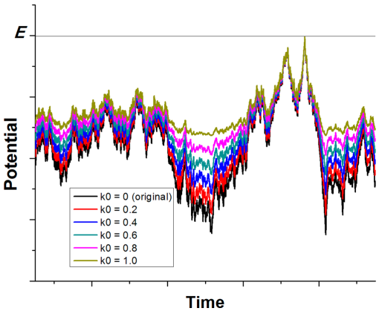

2.4 Physical pathway methods: Accelerated MD
(GaMD)
J Chem Theory Comput. 2015 Aug 11;11(8):3584-3595.
predefined CVs unnecessary
provide free-energy landscape
not useful for an accurate estimate of the ligand binding free energy

Slide 13
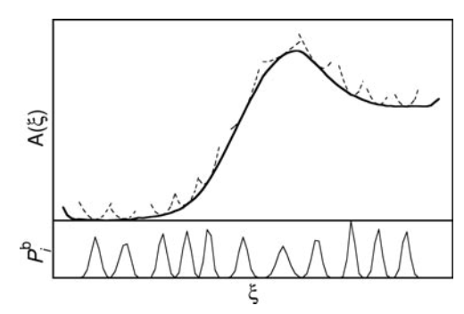



2.4 Physical pathway methods: Umbrella sampling
Analyzing methods:
Weighted Histogram Analysis Method(WHAM)
Umbrella Integration
……
J Comp Phys. 1977;23 (2):187–199
fewer errors caused by user-defined parameters
parallel execution
the same system can convergence to diverse results
exhaustive sampling of the process necessary

Slide 14
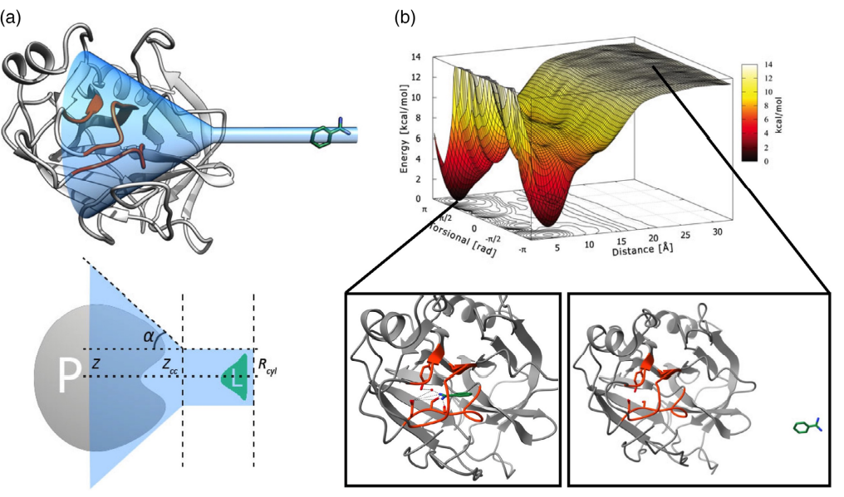

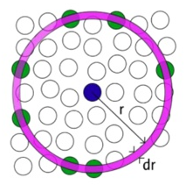
2.4 Physical pathway methods: Funnel-Metadynamics
Wref: 由 potential of mean force (pmf)导出。
PMF：两分子沿着反应坐标，整个体系其它所有分子对两分子有作用力，最后得到的平均效应。可以由径向分布函数得出。
priori knowledge unnecessary
relatively accurate
highly dependent on predefined CVs and funnel
long simulation time

Slide 15

2.4 Physical pathway methods: Steered MD
Jarzynski equality:
SMD: applying an external force to the ligand's center of mass to pull it out from the binding site.
short simulation of one single run(but a large number)
parallel execution
large dissipative
the choice of the direction of the force not trivial

Slide 16
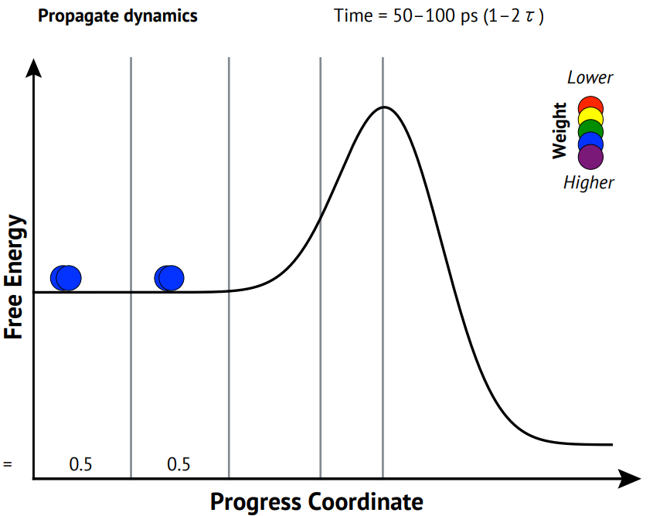
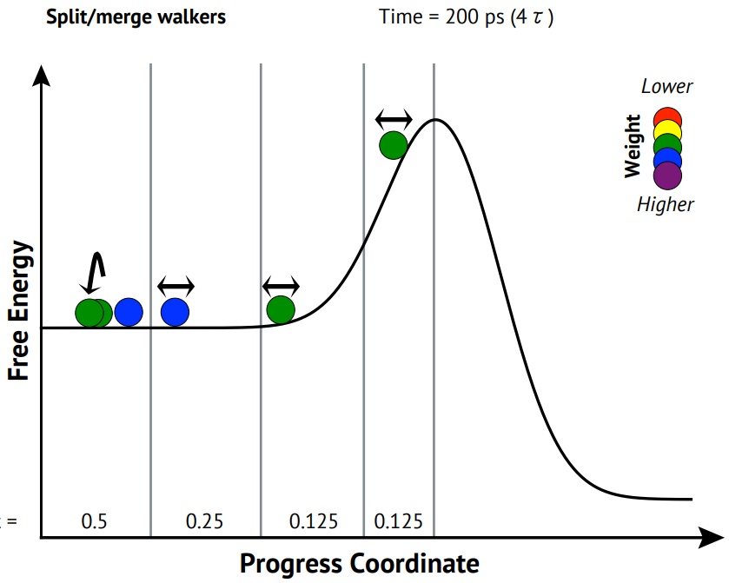
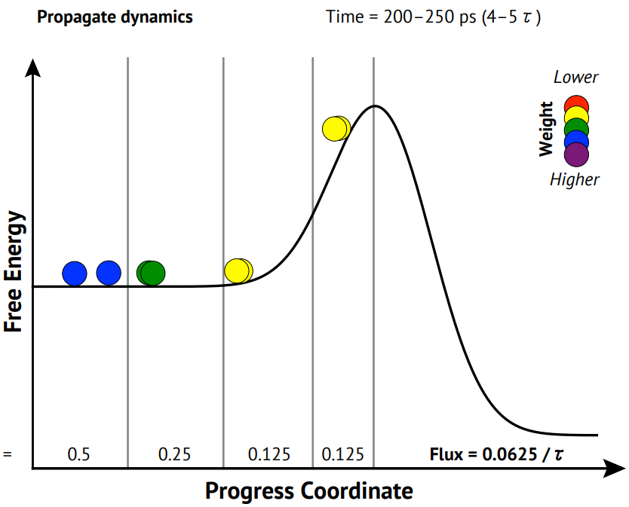
3.2 Physical pathway methods: Weighted ensemble
WExplore
Accelerated WE
not affected by prior assumptions
parallel execution

Slide 17
1.2 Introduction-thermodynamics & kinetics
Thermodynamics can tell you only that a reaction should go because the products are more stable.
K is independent of the reaction mechanism.
Kinetics, on the other hand, can tell you how fast the reaction will go but doesn't tell you anything about the final state of things once it gets there.
Rate constant changes with T and with catalyst. A catalyst would change the activation energy for the rate-determining step.
Thermodynamics and Kinetics (stanford.edu)

Slide 18
Content
1.Introduction
2. Methods for LPB thermodynamics
3.Methods for LPB kinetics
(MD+Statistic model)
4.Summary
3.1 Plain MD
3.2 Markov state model
3.2 Others
Von Mises−Fisher exit distributions
Poisson distribuion
Machine learning
……

Slide 19
3.1 Plain MD
Plain brute force MD can be employed to sample ligand binding mechanism, especially using the latest hardware architectures. In fact, there are examples of microsecond and millisecond timescale MD calculations able to describe ligand binding to different targets.
J. Am. Chem. Soc. 2011, 133, 24, 9181–9183
Proc Natl Acad Sci U S A. 2011 Nov 15;108(46):18684-9
......

Slide 20

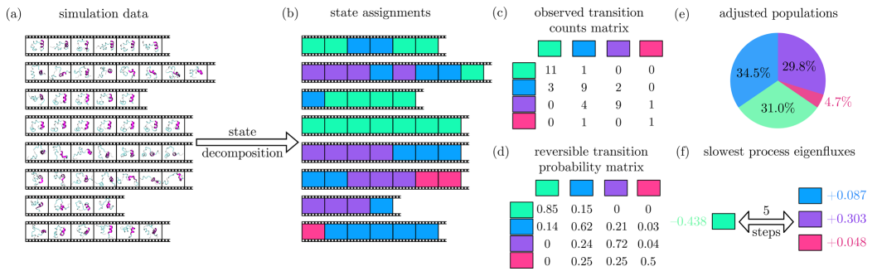
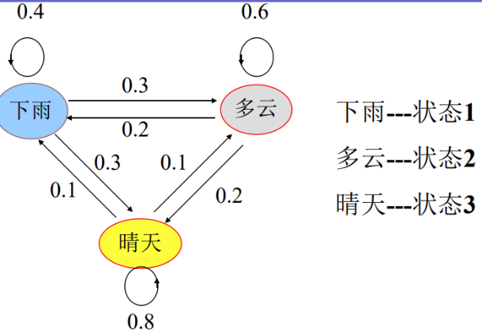
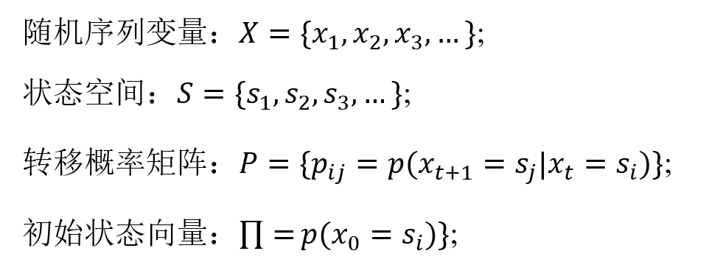
3.2 Markov state model (MSM)
Markov process:
Markov chain:
J. Am. Chem. Soc. 2018, 140, 7, 2386–2396
simple method to estimate transition rate
the way the trajectory partitioned into macrostates
the choice of the direction of the force not trivial

Slide 21
3.3 Others
Von Mises−Fisher exit distributions (infrequent metadynamics)
Machine learning
……

Slide 22
Content
1.Introduction
2.Methods for LPB thermodynamics
3.Methods for LPB kinetics
4.Summary

Slide 23
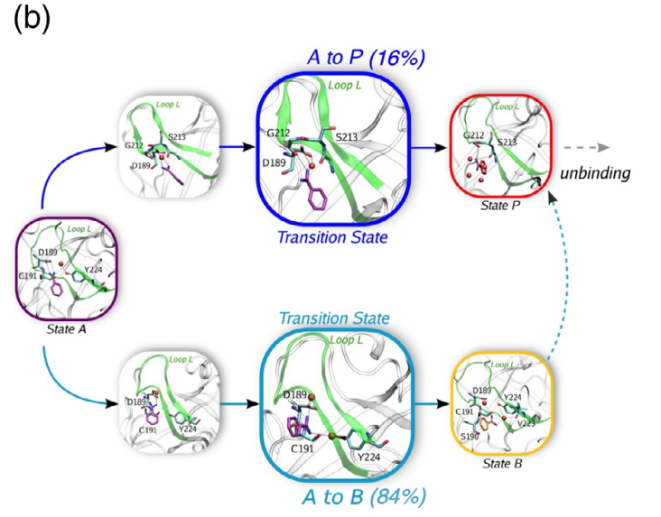
4.Summary
LPB kinetics problem = Transition state problem = Sampling problem + Trajectory analysis problem
Sampling problem = bredth(different pathways) + height(high potential energy) +width(lone time scale)

Slide 24
THANK YOU

