Slide 1

Predicting Biomolecular Binding Kinetics: A Review
Jinan Wang, Hung N. Do, Kushal Koirala, and Yinglong Miao
Journal of Chemical Theory and Computation DOI: 10.1021/acs.jctc.2c01085
汇报人： 吴乐云
2023年04月19日

Slide 2
Content
1) Available experimental techniques to measure binding kinetics
2) Quantitative structure-kinetic relationships (QSKRs)
3) Molecular dynamics and enhanced sampling methods
4) Weighted Ensemble MD Simulations
5) Conclusion: REMD and Trypsine-Benzamidine
Notes:
定量结构-动力学关系
加权系综MD模拟

Slide 3
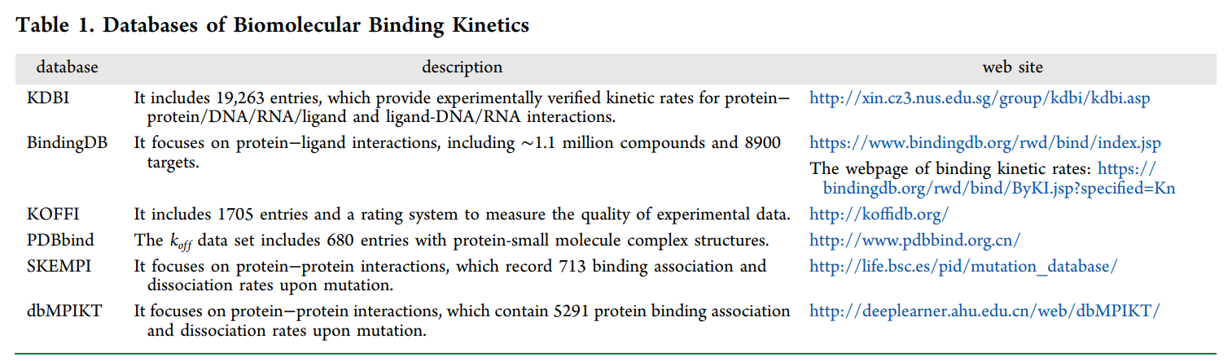
Available experimental techniques to measure binding kinetics
Assays |  | Notes
With label | Radio (radioactive isotopes) | Allowing for spontaneous measurement of binding kinetic rates
 | Spectroscopic (fluorophore groups) | 1) Fluorescent resonance energy transfer (FRET) 2) less effective, labor intensive and challenging for certain drugs
Without label | Surface plasmon resonance (SPR) | High throughput is one important advantage

Slide 4
Quantitative structure-kinetic relationships (QSKRs)
Methods | Description | Notes
COMparative BINding Energy (COMBINE) | Using holo structure to predict binding parameters; Including extra options of using multiple protein-ligand complex structures | The predictive power was lower than the model from a single, energy-minimized crystal structure.
Matched molecular pair analysis (MMP) | To elucidate the impact of small structural changes on the binding kinetic behavior; 395 MMPs extracted from K4DD database | 1) The largest differences in k_{on} were found with the introduction of a charged moiety; the decrease in k_{on} might come from electrostatic repulsion and/or desolvation penalties; 2) The change of molecular polarity in the MMPs did not produce a consistent shift in k_{off}
Coarse-grained normal-mode with multitarget machine learning (NMA + MTML) | To explore molecular details of biomolecular binding process on a large scale | 1) The prediction accuracy was higher than that of the random guess; 2) The coherent coupling of conformational dynamics and thermodynamic interactions played a critical role in binding kinetic rates
The built QSKR will become more accurate and allow for high-throughput screening, which is very helpful at the early stage of drug design.
Notes:
匹配分子对分析

Slide 5
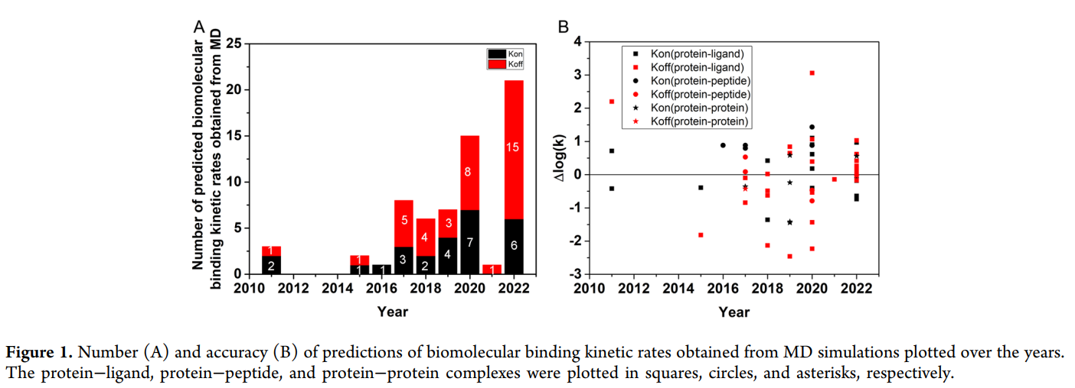
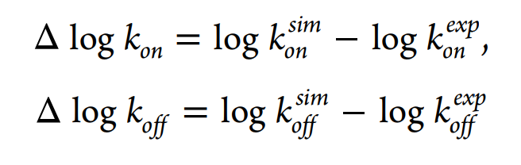
Molecular dynamics and enhanced sampling methods
Number of predictions
cMD simulations have been widely applied to investigate k_{on}
It is still challenging to simulate repetitive dissociation and rebinding processes
The prediction errors of kinetic rate:
Accuracy of predictions
Due to the difficulty of prediction in ligand binding kinetic rates, Δlogk_{off} in the range of -2 to 2 is acceptable.

Slide 6
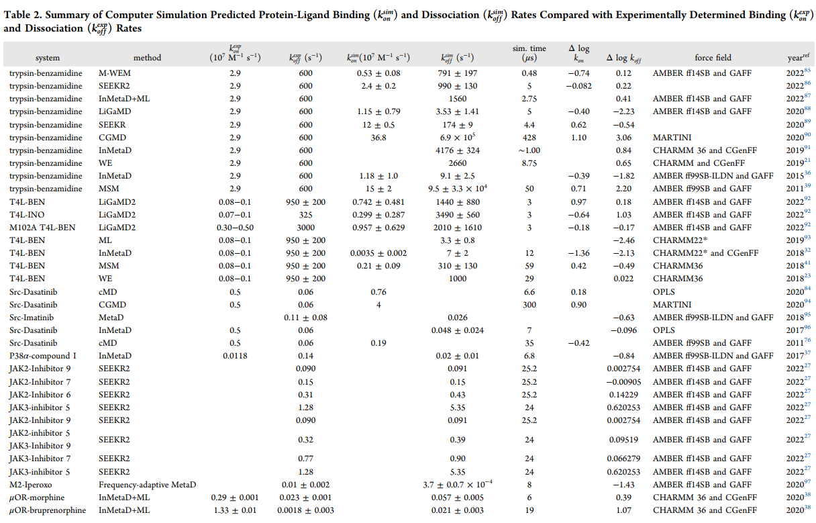

Slide 7
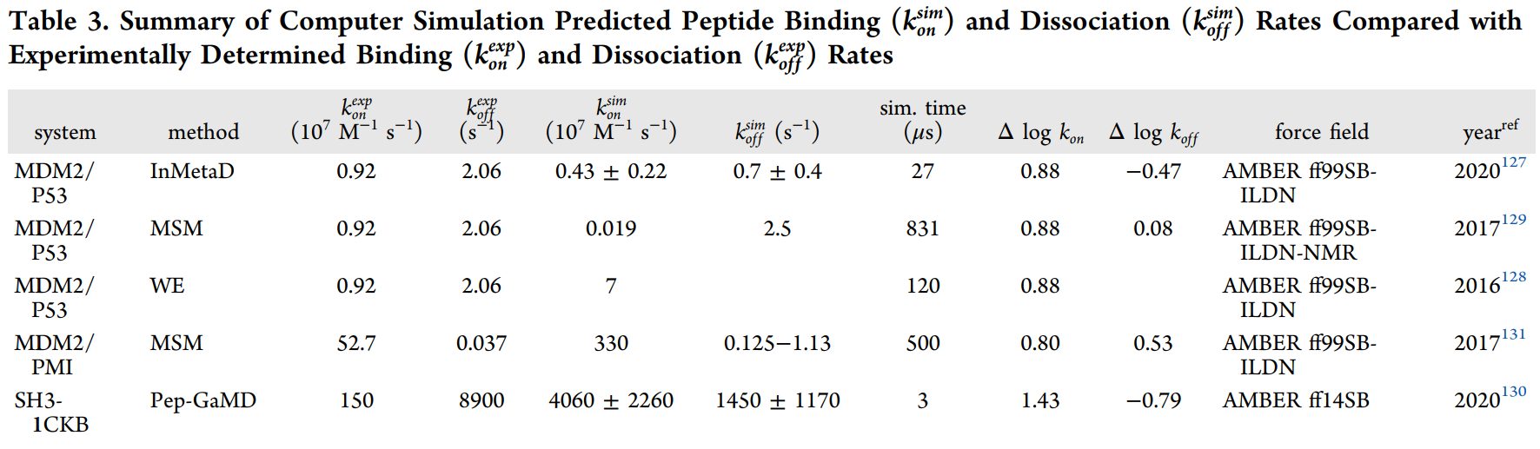
Protein-Peptide

Slide 8
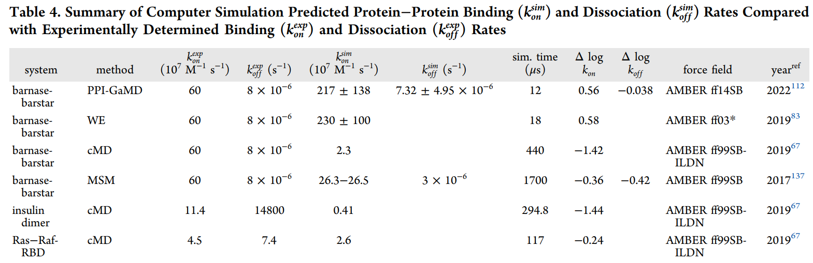
Protein-Protein
The protein-protein binding affinity is often stronger than that of the protein-small molecule and protein-peptide interactions.

Slide 9
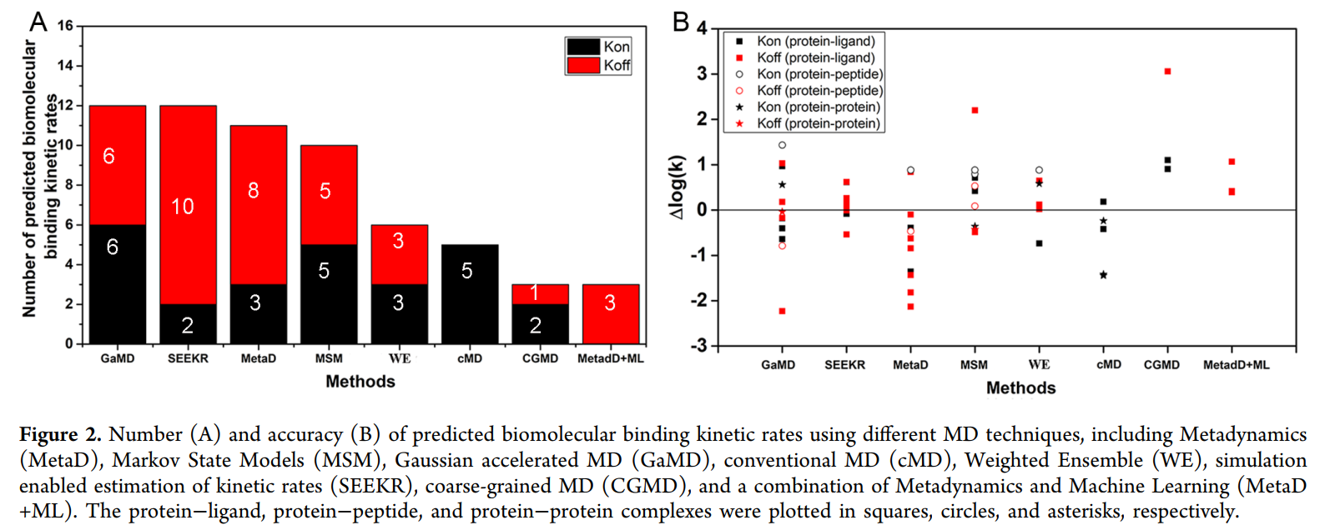
Molecular dynamics and enhanced sampling methods
Number of predictions
GaMD: limitations?
SEEKR: multiscale simulation approach (MD + Brownian dynamics + milestoning)
MetaD: requires expert to defining CVs. The simulations may suffer a “hidden energy barrier” problem if important CVs were missed during the simulation setup.
MSM: requires very expensive computational resources
Weighted Ensemble: no bias is introduced into the ensemble dynamics, enabling direct estimates of rate constants
Accuracy of predictions

Slide 11
Molecular dynamics and enhanced sampling methods
Number of predictions
GaMD: Limitations?
SEEKR: multiscale simulation approach (MD + Brownian dynamics + milestoning)
MetaD: requires expert to defining CVs. The simulations may suffer a “hidden energy barrer” problem if important CVs were missed during the simulation setup.
MSM: requires very expensive computational resources
Weighted Ensemble: no bias is introduced into the ensemble dynamics, enabling direct estimates of rate constants
Accuracy of predictions

Slide 12
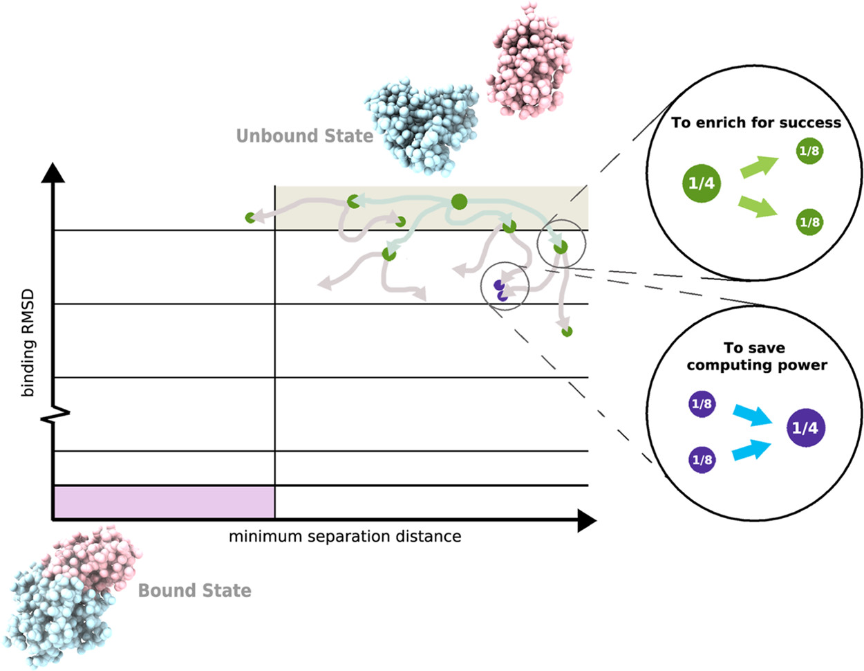
Weighted Ensemble MD Simulations
Basic WE protocol
1) a two-dimensional progress coordinate is divided into bins with the goal of occupying each bin with a target number of four trajectories.
2) Four equally weighted trajectories are initiated from the unbound state and subjected to a resampling procedure at periodic time intervals τ for the following:
(i) to enrich for success, trajectories that make transitions to less-visited bins are replicated to generate a target of four trajectories in these bins, splitting the weights evenly among the child trajectories (green spheres) and
(ii) to save computing time, the lowest-weight trajectories in bins that have exceeded four trajectories are terminated, merging their weights with those of higher-weight trajectories in these bins (purple spheres). Spheres are sized according to their statistical weights.
J. Chem. Theory Comput. 2022, 18, 2, 638–649
https://pubs.acs.org/doi/10.1021/acs.jctc.1c01154
Notes:
WESTPA 2.0: High-Performance Upgrades for Weighted Ensemble Simulations and Analysis of Longer-Timescale Applications | Journal of Chemical Theory and Computation (acs.org)

Slide 13
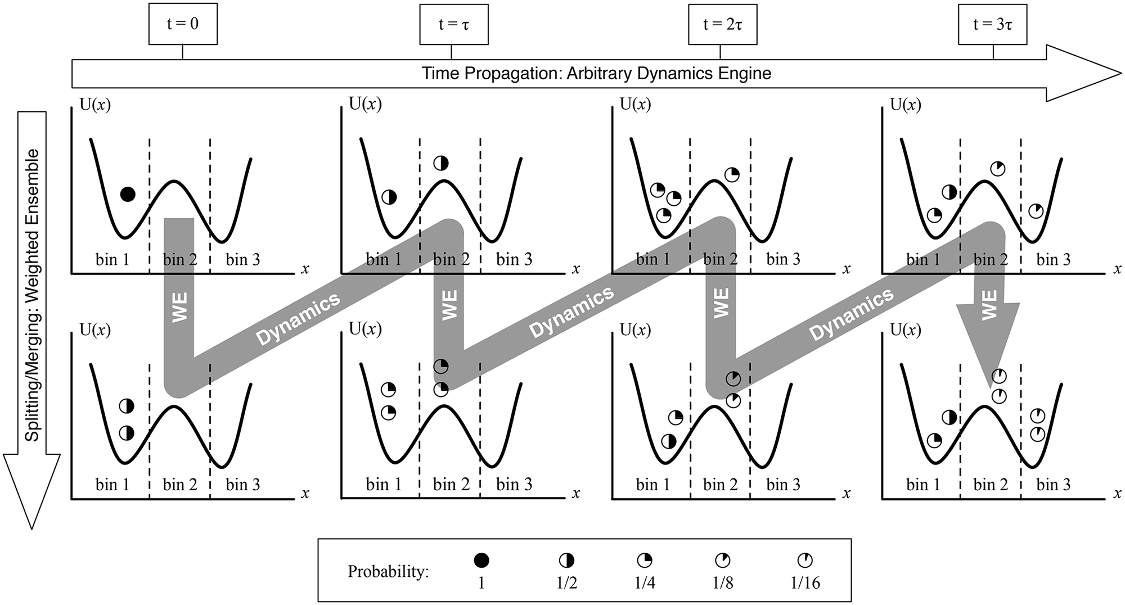
Donovan RM, Tapia JJ, Sullivan DP, Faeder JR, Murphy RF, et al. (2016) Unbiased Rare Event Sampling in Spatial Stochastic Systems Biology Models Using a Weighted Ensemble of Trajectories. PLOS Computational Biology 12(2): e1004611. https://doi.org/10.1371/journal.pcbi.1004611
https://journals.plos.org/ploscompbiol/article?id=10.1371/journal.pcbi.1004611

Slide 15
Conclusion
与REMD相关的k_{off}和k_{on}（Protein-ligand）预测目前仍是难题
系统关注REMD模拟的多肽/RNA的kinetic统计模型 → kinetics from REMD (综述)
2006, Physical Review Letters, Protein folding kinetics and thermodynamics from atomistic simulation
2008, Physical Review, Peptide folding kinetics from replica exchange molecular dynamics
2011, J. Am. Chem. Soc., What is the time scale for α-helix nucleation?
2016, PNAS, Multiensemble Markov models of molecular thermodynamics and kinetics
2017, The Journal of Chemical Physics, Peptide dimerization-dissociation rates from REMD
2017, JCTC, Kinetics from replica exchange molecular dynamics simulations （作者公开了源码）
已在本地服务器配置完成环境和源代码，近期在尝试复现文章中的结果
2）WE可以尝试与vsREMD模拟结合，以提高过渡态的采样概率
相当于给副本更换不同的初始构象

Slide 16
Trypsine-benzamidine
1）配体结合位点：目前的聚类参数下得到的最优构象是否为晶体结构的结合位点，如果不是，再根据对照体系的复合物晶体结构寻找原因（PDB ID：3PTB）
2）k_{off}/k_{on}：有湿实验测得数据，k_{off}为 0.06 * 10⁴ (s⁻¹)，k_{on}为 0.29 * 10⁸ (M⁻¹s⁻¹)
3）配体结构简单，蛋白质体积较小
4）配体benzamidine为上市药物（https://go.drugbank.com/drugs/DB03127#BE0001739）

Slide 17
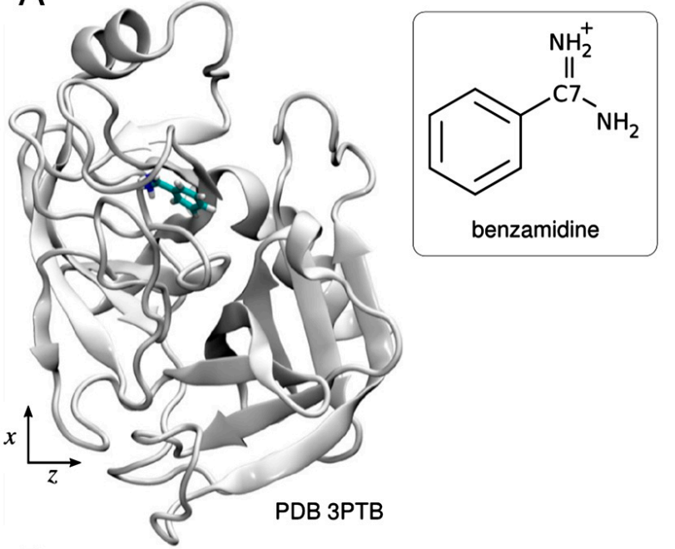
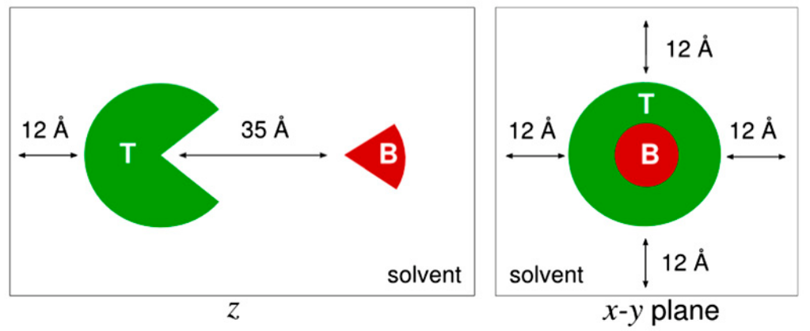
Trypsine-benzamidine
初始构象的准备：
System setup. Trypsin (T) and benzamidine (B) are separated by a distance of 35 Å along z first, and then solvated with a TIP3P waterbox extending 12 Å from any atom in all directions.
1）副本初始构象是否给晶体结构？
2）是否保留晶体结构中的水？
PNAS, 2011 Vol. 108 Issue 25 Pages 10184-9

