Slide 1
Developing Nonstandard Parameters
A modified amino acid residue
Amber Basic Tutorials - Tutorial A26 (ambermd.org)
Leyun Wu 2024.04.23

Slide 2
Preparing parameters for Hse
Methods: Gaussian, B3LYP/6-311G**, vacuum
antechamber -i Hse.sdf -fi sdf -o Hse.gjf -fo gcrt -at amber -gn "%nproc=8" -gm "%mem=4GB" -gk "#B3LYP/6-311G* opt pop=MK iop(6/33=2,6/42=6)" -rn Hse -ch Hse -nc 0
nohup g16 Hse.gjf &
mkdir antechamber
cd antechamber
antechamber -fi gout -i ../Hse.log -fo ac -o Hse.ac -c resp -at amber -rn Hse
Hse

Slide 3
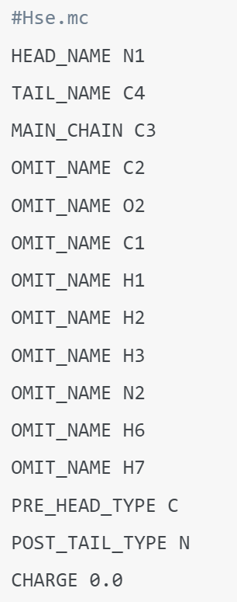
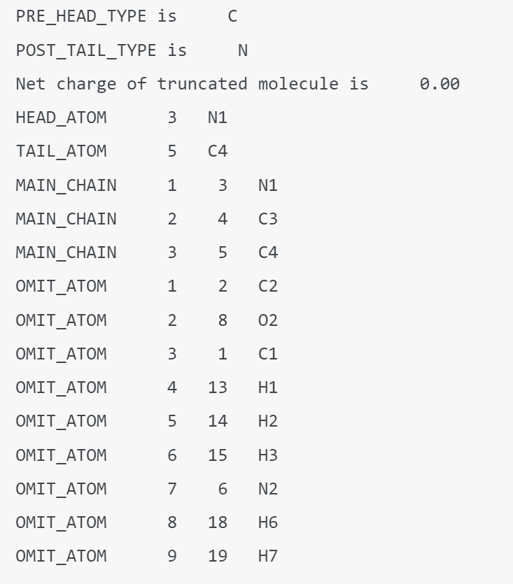
Preparing parameters for Hse
prepgen -i Hse.ac -o Hse.prepin -m Hse.mc -rn Hse
Hse

Slide 4
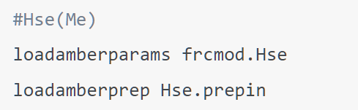
Preparing parameters for Hse
parmchk2 -i Hse.prepin -f prepi -o frcmod.Hse -a Y -p parm10.dat
Hse

